Slide 1
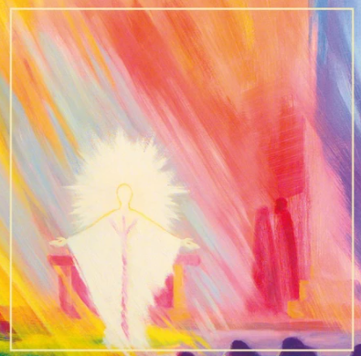
Meeting Christ
in the
Sacraments
A Sacramental meeting for Parents
^{Wednesday 1st October}

Slide 2
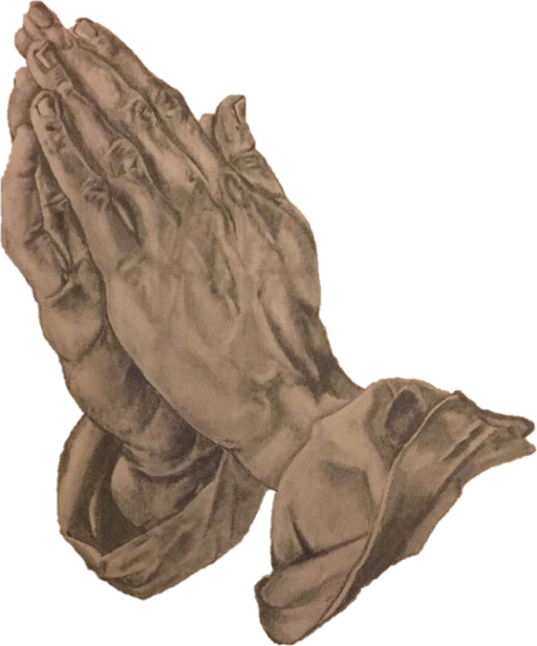
Prayer fromFather
God of love, In you we find the source of all love. We your people gather now, Believing in your unconditional love for all. May we who have been entrusted With the faith formation of our children, Be given the grace we need To draw our children into the mystery of your love, Through our loving care of them.
Amen.

Slide 3
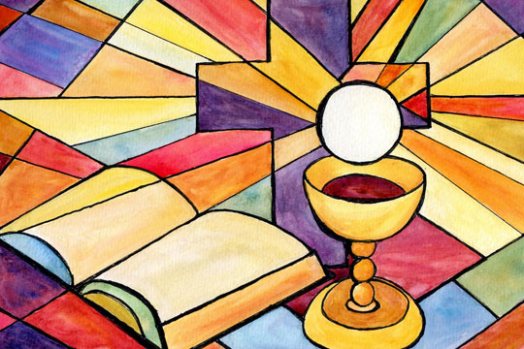
Welcome
A special year.
Family occasion.
Two Sacraments – outward signs of our Catholic Faith in a
Catholic School community
Parents also examine their own Faith
Special time for children in Year 3
Weekly Mass
Notes:
P: Good evening, thank you for joining us this evening. We feel very privileged to be your children’s class teacher this year as they continue on their journey of faith and receive two sacraments this year. It will be a special family occasion and all three of us fondly remember making these Sacraments ourselves.
These two sacraments are an outward sign of our Catholic Faith in a Catholic School community and also gives parents an opportunity to examiner their own faith. This will be a special time for children in Year 3 and we will prepare the children throughout the year. This is an opportunity to celebrate their faith with the class.
It is important that children attend weekly Mass, and they have their Mass cards signed.

Slide 4
Important Dates
Year 3 and Year 6 Mass of Commitment- 14th December Reconciliation meeting to outline the day
Sacrament of Reconciliation (School uniform should be worn)
1St March, 2pm
First Holy Communion meeting
First Holy Communion- 10th May, 1pm
Mass of Thanksgiving- 17th May, 10:15am
Notes:
S: Mass of Thanksgiving- an opportunity to attend Mass in your FHC outfits and receive your certificate.

Slide 5
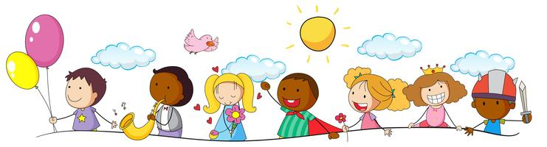
What do we want for our children?
Happy
Confident
Independent
Healthy
Well-educated
Notes:
H:

Slide 6
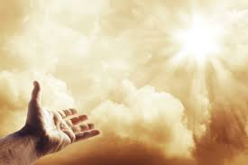
Children also need spiritual nourishment to ensure that they have purpose in their lives and become the people that God created them to be.
What is a sacrament?
Discuss
Notes:
H

Slide 7
The sacraments are where we meet Christ, where God’s action, in Christ, through the Church, transforms us, bringing us to what God wants us to be.
It was Augustine who called a sacrament ‘a visible sign of invisible grace’
Notes:
P

Slide 8

How many sacraments are there?
Can we name them all?
Notes:
P

Slide 9
The Sacraments the children will receive this year are the only sacraments that we receive over and over again.
Pope Leo talks about the Eucharist and why it is essential that we go to Mass.
“The Eucharist is such a great gift”
Notes:
S: The Sacrament of Holy Communion is so important as we regularly receive this Sacrament.

Slide 10
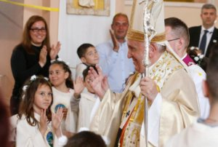
It’s important for children to prepare for these sacraments. There are a number of ways to undertake this
Attending Mass as a family at the weekend
Praying as a family
Reading the Bible
Talking about how God would want us to behave and live our lives.
Notes:
S: Each day, reflecting on the day. An examination of conscious.

Slide 11

Passing on our faith
You have chosen to give the gift of faith to your child through their Baptism. It is a partnership between school, home and parish. We ask the children to bring their baptismal candles into school so that we can use them in the next part of their faith journey.
Notes:
H

Slide 12
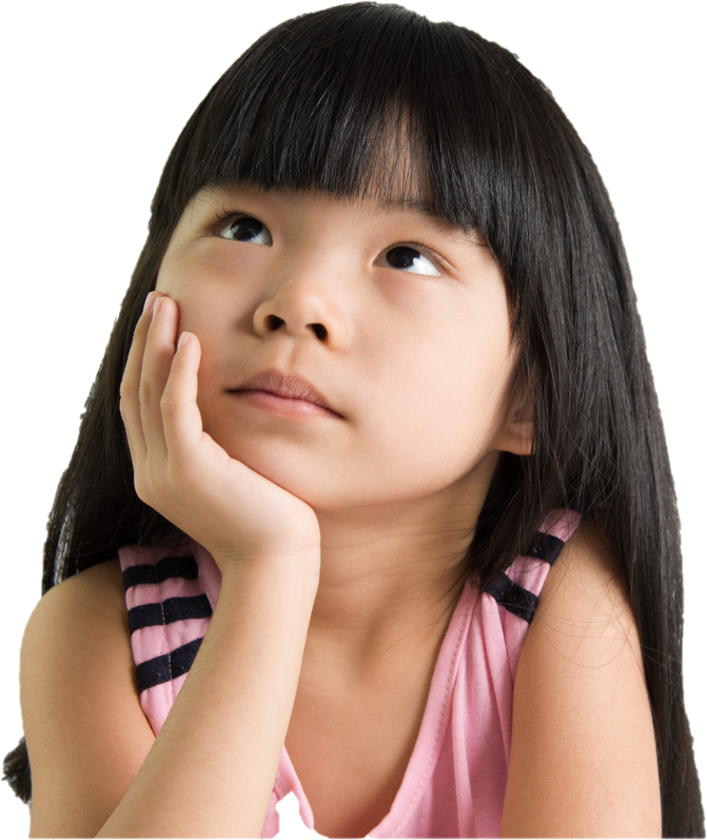
Why did you have your child baptised?
Who is Jesus to you?
Why is baptism important?
Short reading by child
Notes:
H- We are inspired by Jesus. Luca will come and read a passage about Jesus’ baptism.
ask question. Child read passage about Baptism.
Talk to your child about your own baptism.

Slide 13
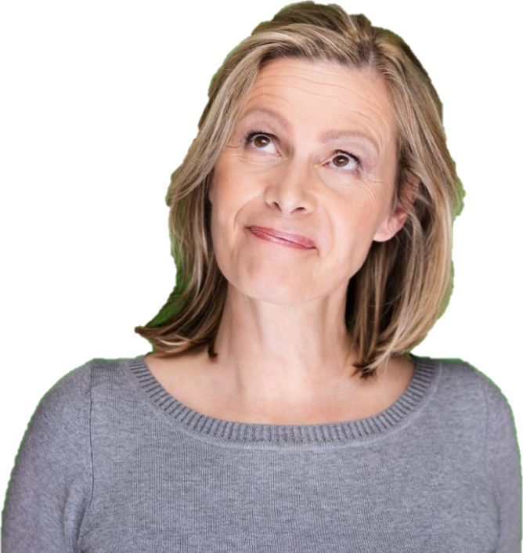
Can you remember receiving the Sacrament of Reconciliation, or going to your First Confession? Can you remember your FH?
Briefly tell your child about
your experience
What do you remember?
Notes:
P-As we said earlier, we have fond memories of receiving the Sacrament of Reconciliation and FHC. I remember…”golden book” “ feeling of maturity and closeness to God”
You will receive an I Belong Book which we wil share details of in our next meeting.
Say how nice the Sacrament of Reconciliation is at St Edward’s- true celebration.
ACTIVITY- with your child. Can you write a prayer for your faith journey. What do you want God to guide you with?

Slide 14
Sacramental preparation…..
What will it look like?
Notes:
P- meetings (all should be attended with the children. This is a journey they go on together,
Mass of Commitment.
Units they will learn about in school- Reconciliation and Eucharist as a Thanksgiving to God.
All of our RE units have these links
I Belong book sent out after Christmas.
Sacrament of Reconciliation
Sacrament of FHC
There will be a meeting before each Sacrament.

Slide 15
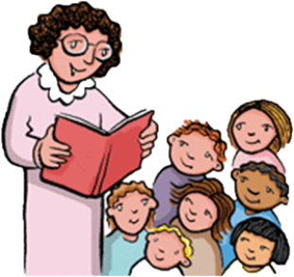
Sunday Mass
We do celebrate Mass in school or church every Wednesday, however, this does not replace your obligation to attend Mass at the weekend.
Praying together as a family is so important it sets a good example.
Together with your child, we would like you to write a prayer asking for God’s support on this Sacramental journey.
Notes:
S

Slide 16
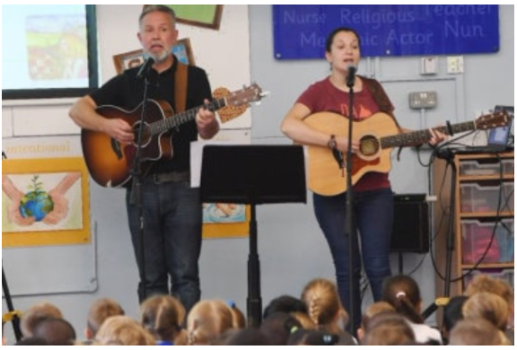
Retreat day with Dan and Emily
Notes:
P 21st April 2026- a wonderful opportunity
hese are very special days for the whole class and their teachers. Through music, prayer, team building, plenty of fun and specially designed activities, these days has been put together to gently strengthen the faith of the entire year group, whilst focusing on Jesus the giver of life whom many will receive for the first time in the Sacrament of Holy Communion.

Slide 17
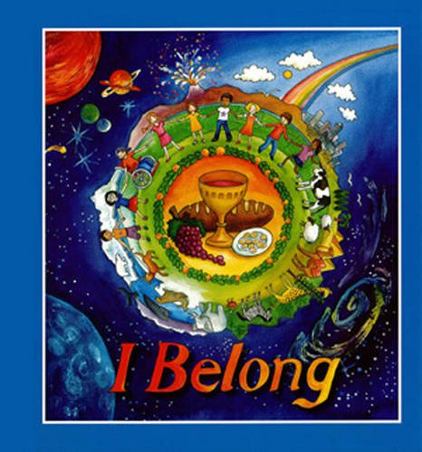
I Belong Books
Notes:
S- I Belong is a programme that contains lively, colourful material in which illustrations and examples are used to reflect the world where today’s children live and experience faith. It is hoped that the children using this book will create a personal momento of this special time in their relationship with God. At the end of each chapter is a “Family Time” page with suggestions for prayer and something to do together as a family. Small information boxes have been added throughout the book. These cover areas such as:search the church for particular items, explanation of Catholic practices, what to look out for while at Mass and new words associated with reconciliation, First Holy Communion and the Mass. There is also a symbol of a Bible to check out bible references at the end of scripture passages. A small candle features on the corner of each page which, when coloured, indicates progress through the book.

Slide 18
Your Child’s Holy Communion
Your child’s First Holy Communion day is a very special occasion. It is part of their faith journey and the next step in their Catholic life.
Helping to plan what they will wear and how they will celebrate with family and friends helps to emphasise the importance of receiving the Eucharist for the first time.
Notes:
H

Slide 19
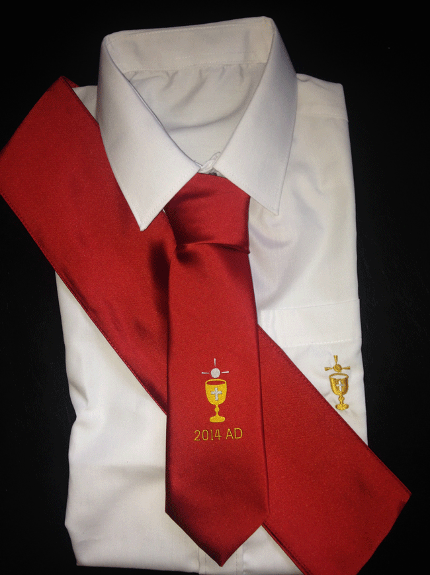
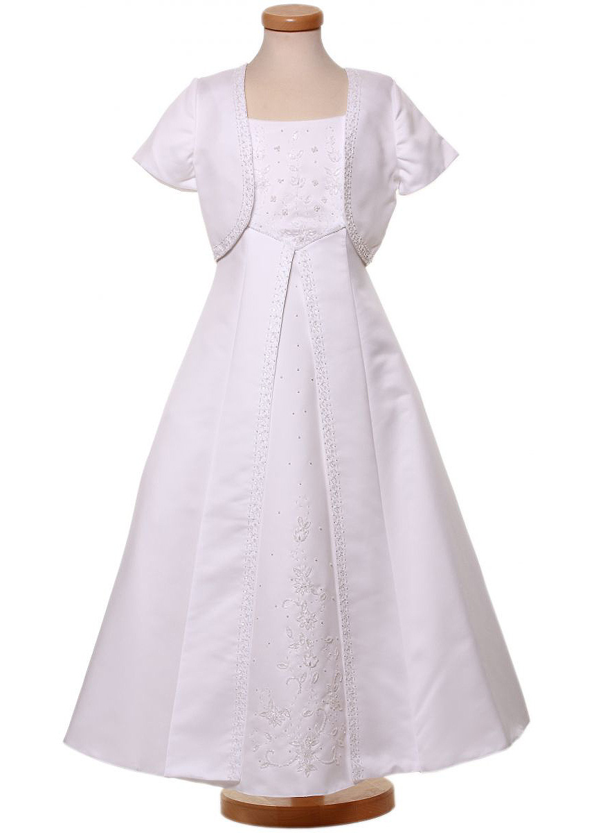
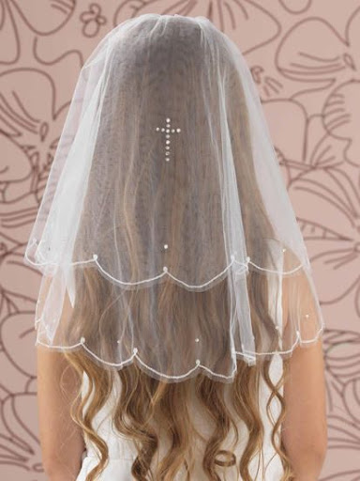
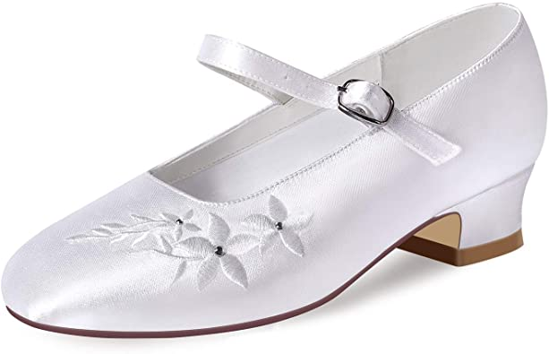
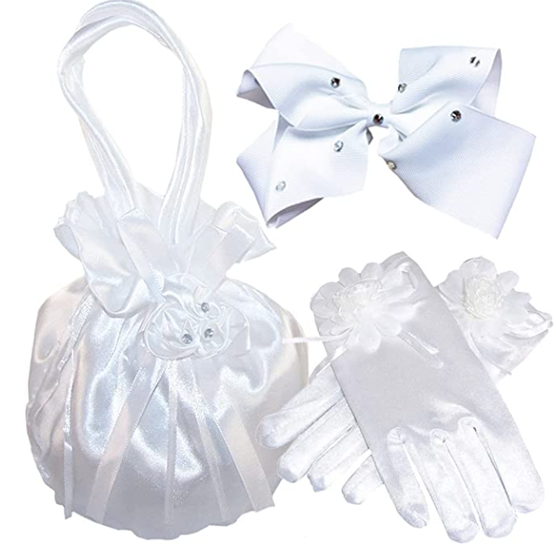
Notes:
H Provided by school?

Slide 20
Prayer for Sacramental Preparation
Loving God, Pour out your blessing Upon our beloved children, That during this time of Sacramental preparation They may grow closer to you, And come to know your special love for them. May this time of preparation be a time of blessing For our families and our community, And unite us all in your great love. Amen.

