Slide 1
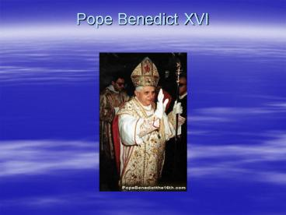

Slide 2
Question:
What is a Pope?
What does a Pope do?

Slide 3
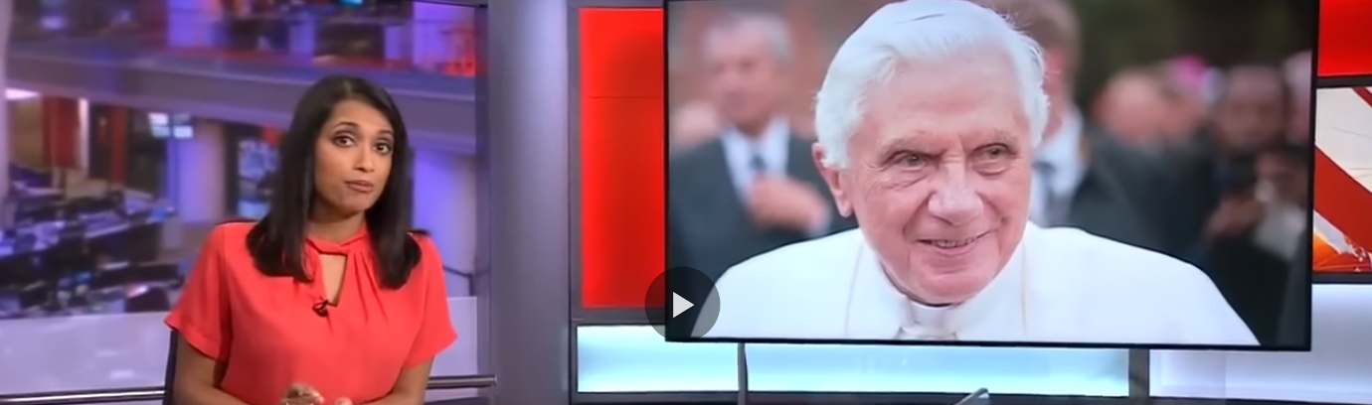
Joseph Ratzinger Pope Benedict XVI

Slide 4
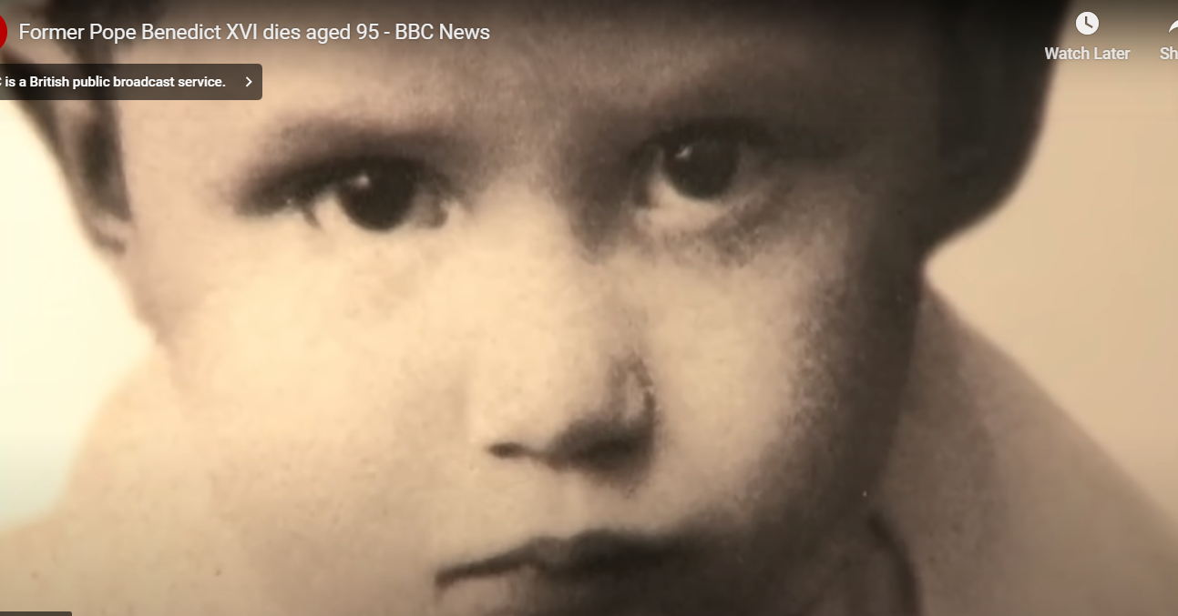
Joseph Ratzinger Pope Benedict XVI Early Years
6 years old
Pope Benedict 16th was born and baptised on April 16th 1927.
His given name was Joseph Ratzinger.
His parents were strong devote Catholics.
Mr. Ratzinger was a policeman and was from a family of farmers.

Slide 5
Pope Benedict’s Education
Joseph went to the Higher School of Philosophy and Theology of Freising and at the University of Munich.
In 1953 he received his university degree in theology.

Slide 6
Pope Benedict’s Ordination
He received his priestly ordination on June 29th 1951.
On March 25th 1977 he was named Archbishop of Munich and Freising.
Later that year he was named Cardinal.

Slide 7
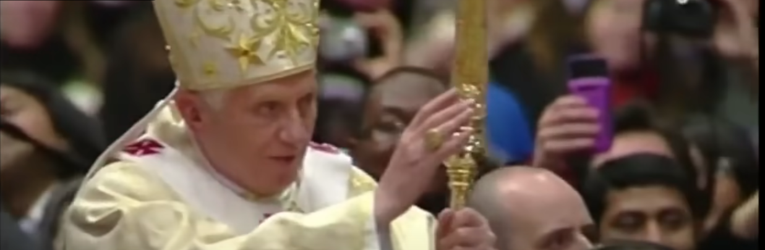
Joseph Ratzinger Pope Benedict XVI
Pope for 8 years

Slide 8
Pope Benedict’s Work
Ratzinger contributed to Vatican II as an expert theologian.
He has published many pieces of literature dealing with theology.
His most notable work was published in 1985 called The Ratzinger Report.

Slide 9
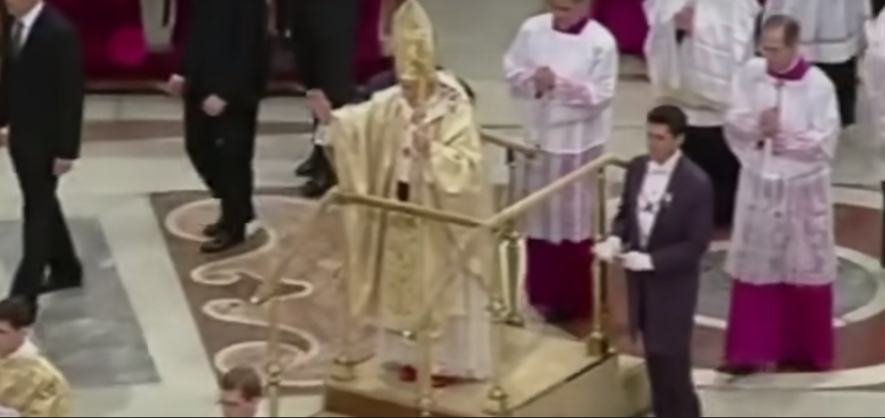
Joseph Ratzinger Pope Benedict XVI
The first Pope to resign in 600 years

Slide 10
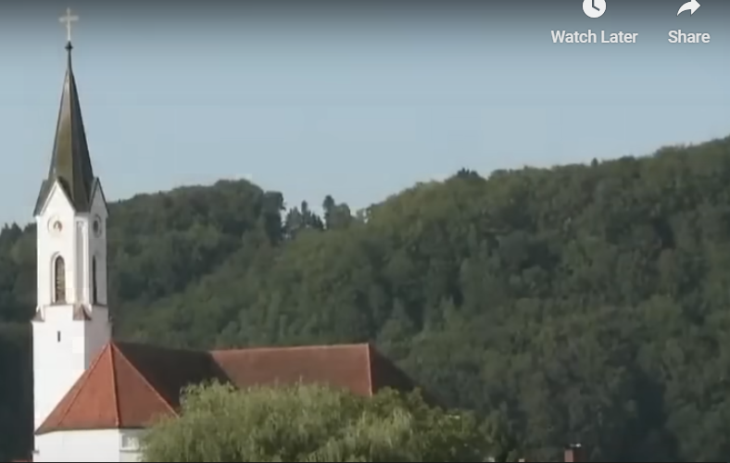
Joseph Ratzinger Pope Benedict XVI
His place of birth was in the country of Germany in a place called Marktl am Inn.

Slide 11
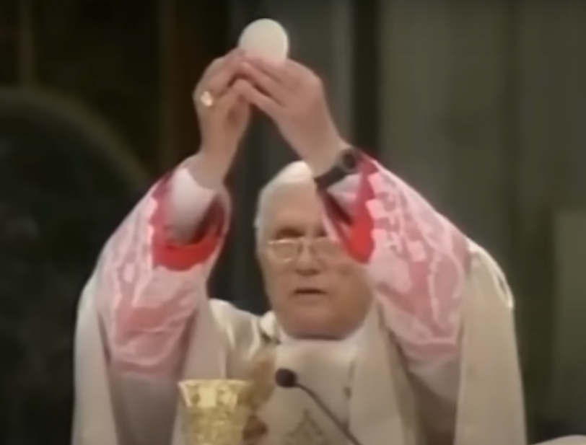
Joseph Ratzinger Pope Benedict XVI
Cardinal in early 50s

Slide 12
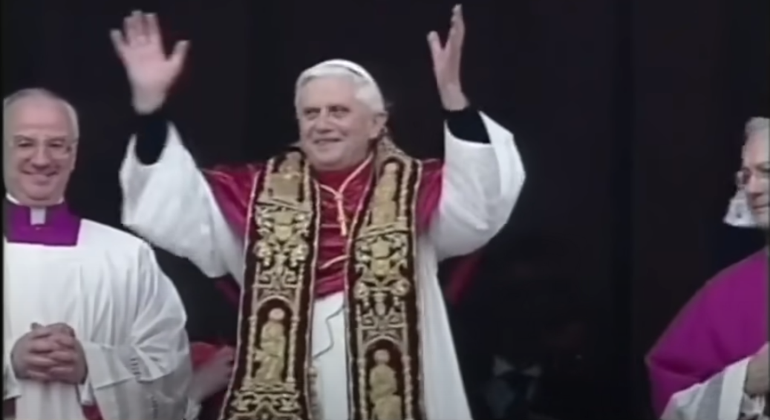
Joseph Ratzinger Pope Benedict XVI
Oldest Pope for 275 years

Slide 13
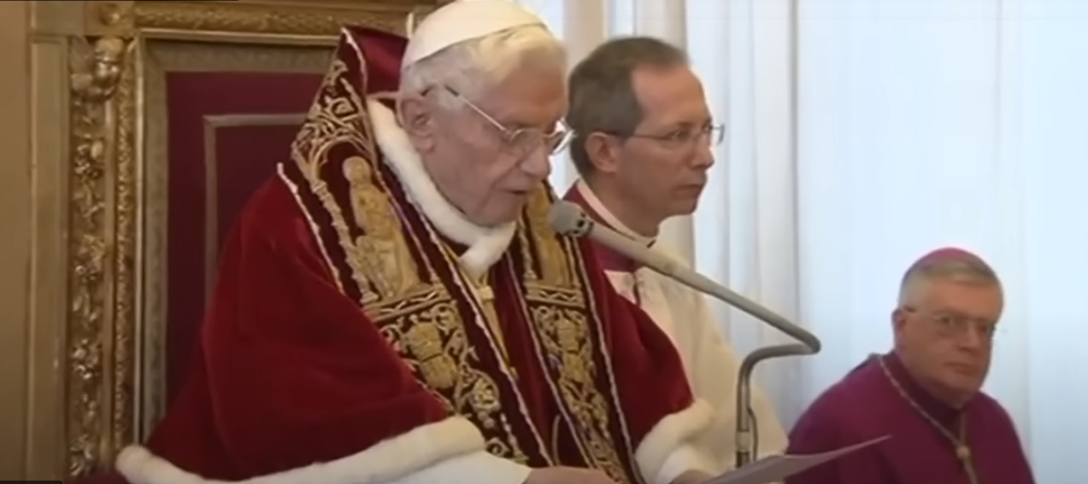
Joseph Ratzinger Pope Benedict XVI
In 2013 he announced his resignation

Slide 14
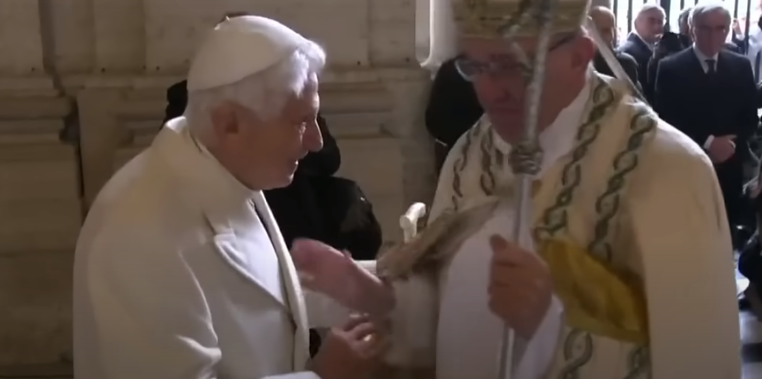
Pope Benedict XVI becomes Pope Francis
Pope Francis took over the Catholic Church

Slide 15
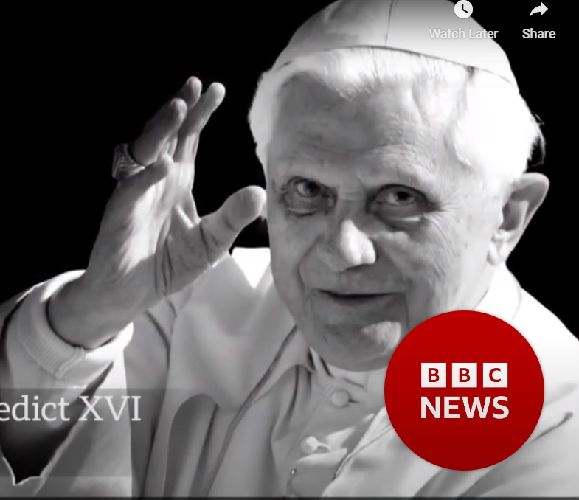
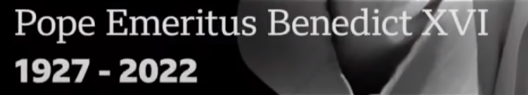
Joseph Ratzinger Pope Benedict XVI Died on 31st December 2022
He hoped and prayed
for
peace when he was alive

