Slide 1
St. Matthew

Slide 2
House Leader of St. Matthew’s is Mrs. Hill
What does it mean being involved within St. Matthew’s House?
We are all part of this team; we help and support each other through both good times and when people in our house are struggling. We strive to do our best everyday we are in school and when we are outside in our local community. Being a part of St. Matthew’s helps us create a strong bond with older/younger children within our school. Within our house of St. Matthew’s we develop our leadership skills by creating a better environment for us all especially within our outdoor areas. We will hold regular meetings to discuss an agenda created by the children and teachers together and devise actions to move these points forward.

Slide 3
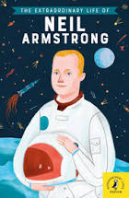
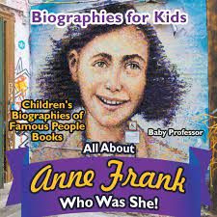
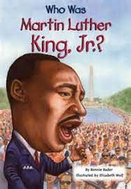
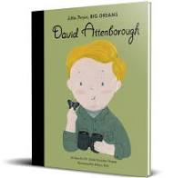
These books are all biographies. A biography is a text written about someone else’s life.

Slide 4
Biography’s
If Mrs. Hill wrote a biography what things would be included in Mrs. Hill’s biography?
Where she is from
Family
Things she likes
Places she likes to go
What kind of person she is…e.g. kind, caring
What kind of things would you include in your own biography? How would you like to be remembered?
Matthew wrote his own biography and this biography can be read in the Bible ...

Slide 5
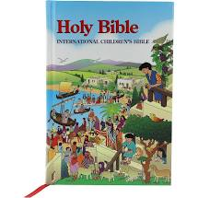
Bible

Slide 6
Bible
The Bible is divided into 2 sections: Old Testament and New Testament. The Old Testament is about the time before Jesus was born and the New Testament is about Jesus’ life and the time afterwards
The Old Testament is one book and the New Testament is another book. These books are written by different people. Do you know who these people are?
Please talk to your parents and tell them if you know the name of the first book in the New Testament.
Activity at Home/School:
Find the New Testament in the Bible and read out the name of the first book

Slide 7
Gospel of Matthew
The first book in the New Testament is the Gospel of Matthew. Yes, this is our house Saint. He is named after one of Jesus’ 12 disciples.

Slide 8
The Story of Matthew
Before Matthew met Jesus, he was called Levi. He was very unpopular because he was a tax collector and worked for the Romans. Tax collectors were often greedy and would cheat people by charging them too much money. Levi was no exception; all he wanted to do was make money and become rich. Then, one day, he met Jesus, who asked him to become one of his followers. Everyone was surprised that Jesus had even spoken to Matthew. They could not understand why Jesus was befriending him; they were even more surprised when Matthew agreed. Jesus accepted Matthew’s invitation to go to his house to have a meal with his friends, but many onlookers were shocked at Jesus’ action. They thought that Jesus should just choose good, honest people to be his friends.

Slide 9
The Story of Matthew
From this extraordinary day, Levi became known as Matthew, which means ‘gift of the Lord’. He left behind his old life, his money and his power, and gave up everything to become one of Jesus’ followers. He devoted his life to telling others about Jesus. He also wrote down his story of Jesus’ life, which is called the Gospel of Matthew, the first book in the New Testament.

Slide 10
Reflection
When Jesus was on Earth, he often spent time with people who were disliked or unpopular with others. Jesus believed that everyone should be allowed a chance for their lives to be changed so that they could have a fresh start.
Activity:
Read each question below and pause after each one…
Do we give people a second chance?
Do we allow people to change?
Do we need to change the way we live our lives?

Slide 11
Prayer
Dear God,
Help us to be willing to give people a second chance,
even when we don’t think they deserve it.
Help us to love and bring peace and joy to people’s lives.
Help us to serve others and to help them whenever we get opportunities.
Amen.

Slide 12
Activity at Home:
KS1: A piece of artwork portraying St. Matthew and his life; it could take the form of collage, painting or drawing. Be creative!
KS2: A description about St. Matthew and why we hold him in such high regard in our school. Please show the similarities between your life and St. Matthew’s life. This task will involve some research as we would like you to demonstrate your knowledge about St. Matthew. This can take any form you see fit. The most creative entry gets a prize!
Entries for both competitions will close on Wednesday 22nd September, so get your thinking caps on!

