Slide 1
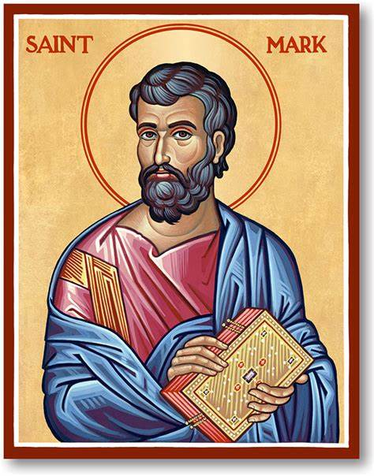
The Feast of St Mark
https://www.youtube.com/watch?v=vipoxy3P1ec

Slide 2


Slide 3
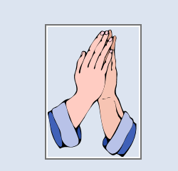
Opening Prayer:
Heavenly Father,
This is our school. Let peace live here
Let the rooms be full of happiness.
Let Love live here; Love of God; Love of another and love of life itself.
Let us remember that as many hands build a house, so many hearts build a school.
Amen

Slide 4

This week is Vocations Week
What job would you like to do when you are older?

Slide 5

Can you guess the vocations from the pictures?
https://www.yout-ube.com/watch?v=X3sIDsuwLJw

Slide 6
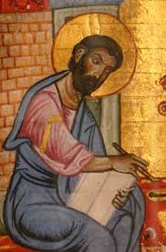
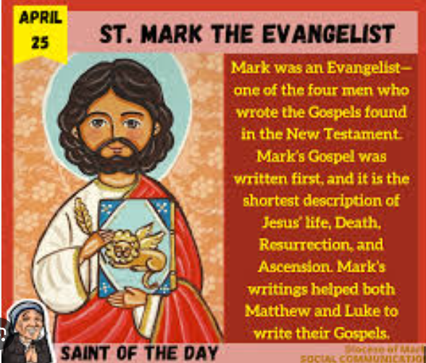
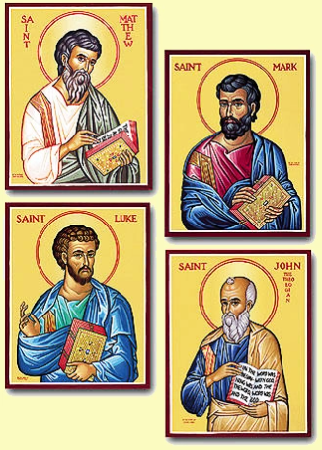
What do you think St Mark’s vocation was?
Can you remember who wrote the other 3 Gospels?

Slide 7
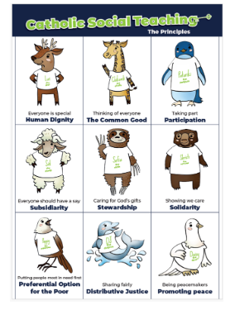

Mark came from a wealthy family and yet he left everything to spread the message of the Risen Jesus Christ. We can’t give away everything we have, but what can we do to spread Jesus’ message today?

Slide 8

How was St Mark eloquent and truthful?

Slide 9
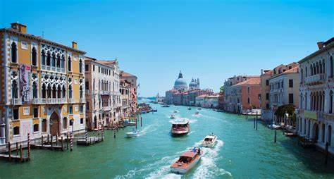
Saint Mark is the Patron Saint of?
Venice

Slide 10
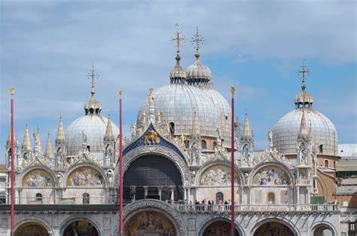
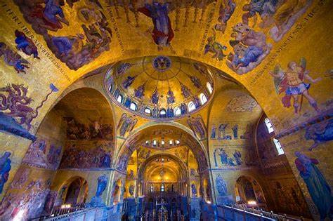
Can you name this famous building in Venice?

Slide 11
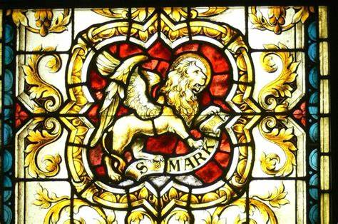
His symbol is……
Why do you think he has this symbol?

Slide 12
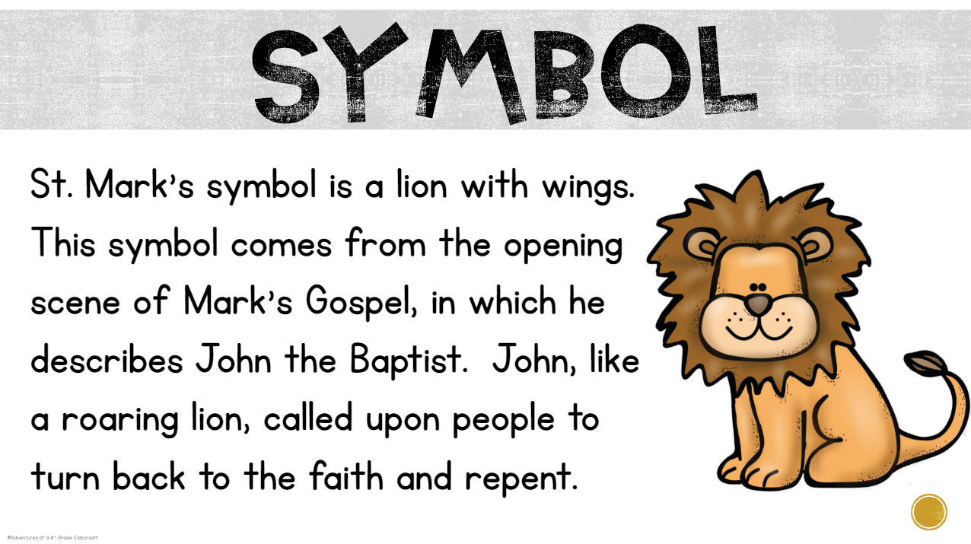

Slide 13
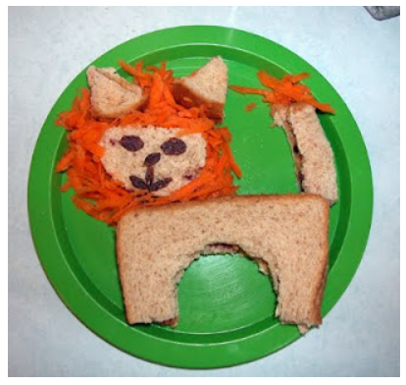
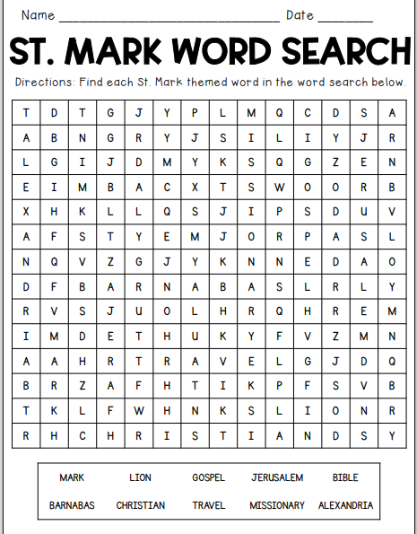
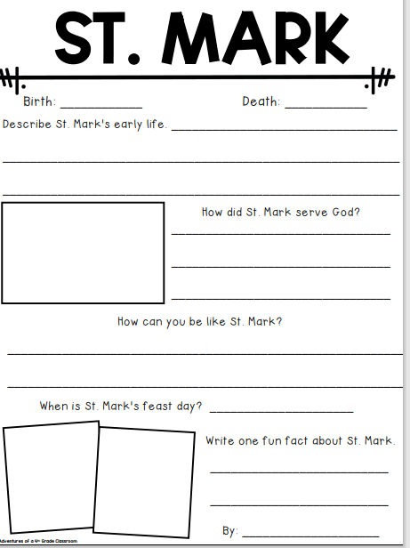
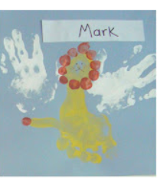
Your Homework:

Slide 14
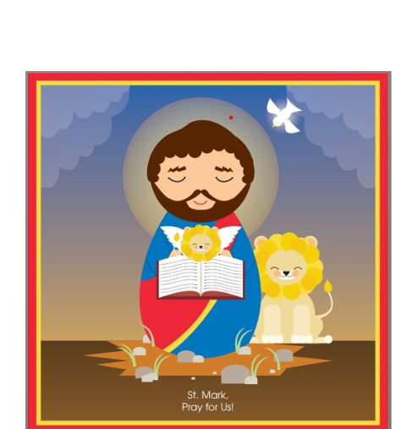
Prayer for St Mark
Heavenly Father,
Thank you
for watching over us
as we learn and play.
Thank you for our patron,
Saint Mark, and his gospel stories.
His words about You show us
how to be respectful, loving
and peaceful.
Please be with us in all we do​,
so that we make choices that honor You. We ask this, in Your name.
Amen

Slide 15
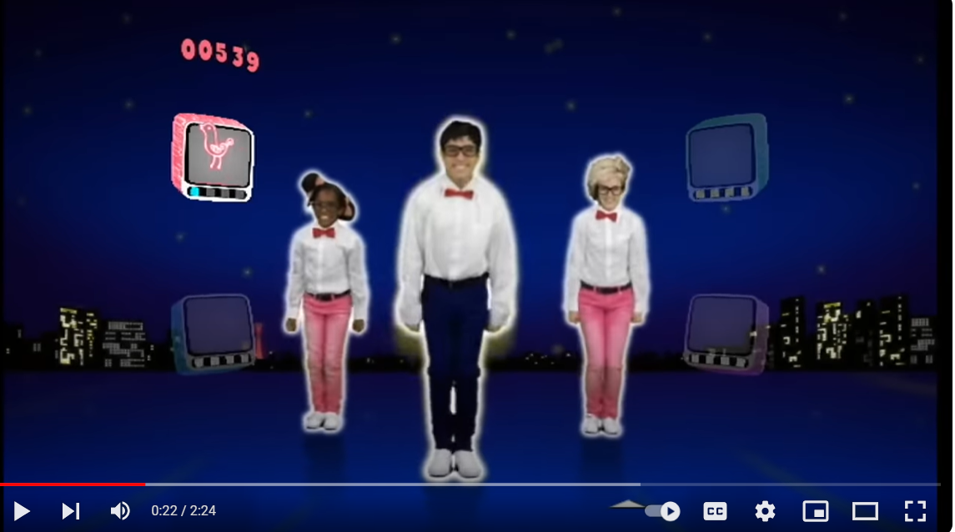
https://www.youtube.com/watch?v=MwRGZ6OgZf0

