Slide 1
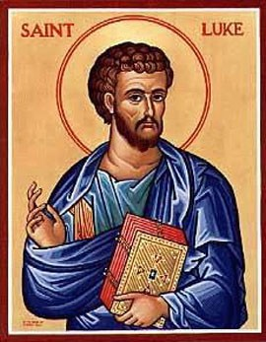
Wednesday 16th October 2024
Feast of St. Luke

Slide 2
Please Stand for the Entrance Hymn – Our God is a great big God
Our God is a great big God,
Our God is a great big God,
Our God is a great big God
And He holds us in His hands.
He’s higher than a skyscraper
And deeper than a submarine.
He’s wider than the universe
And beyond my wildest dreams.
He’s known me and He’s loved me
Before the world began.
How wonderful to be a part
Of God’s amazing plan.
Our God is a great big God,
Our God is a great big God,
Our God is a great big God
And He holds us in His hands.
He’s higher than a skyscraper
And deeper than a submarine.
He’s wider than the universe
And beyond my wildest dreams.
He’s known me and He’s loved me
Before the world began.
How wonderful to be a part
Of God’s amazing plan.

Slide 3
Please Stand for the Entrance Hymn – Here I Am to Worship
Our God is a great big God,
Our God is a great big God,
Our God is a great big God
And He holds us in His hands.

Slide 4
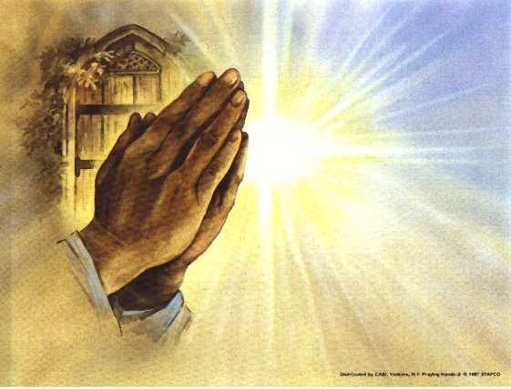
Introduction
The Lord be with you
And with your spirit

Slide 5
Penitential Act
Oh Lord I am sorry, that I have caused you pain,
And I ask you to forgive me, I will try again.
Oh Lord I am sorry, that I have caused you pain,
And I ask you to forgive me, I will try again.
Oh I know your love is boundless, only ask and you’ll forgive.
Open up your sacred heart, let me rest within.
Oh Lord I am sorry, that I have caused you pain,
And I ask you to forgive me, I will try again.

Slide 6
First Reading
Is a reading from the second letter of Saint Paul to Timothy
The word of the Lord
Thanks be to God

Slide 7
The response to the psalm is:
Your Friends, O Lord, shall make known the glorious splendour of your reign.

Slide 8
Please stand to greet the Gospel
Alleluia, Alleluia
Alleluia, Alleluia!
I chose you from the world to go out and bear fruit, fruit that will last, says the Lord.
Alleluia, Alleluia
Alleluia, Alleluia!

Slide 9

The Lord be with you
And with your spirit
A reading from the holy Gospel according to Luke
Glory to you, O Lord.
The Gospel of the Lord
Praise to you, Lord Jesus Christ

Slide 10
Homily

Slide 11
Intercessions

Slide 12
Offertory Hymn-
As I kneel before you,
As I bow my head in prayer,
Take this day, make it yours
And fill me with your love.
Ave Maria, Gratia plena,
Dominus tecum, Benedicta tu.
All I have I give you,
Every dream and wish are yours,
Mother of Christ, Mother of mine,
Present them to my Lord.
Ave Maria, Gratia plena,
Dominus tecum, Benedicta tu.
As I kneel before you,
And I see your smiling face,
Ev’ry thought, ev’ry word
Is lost in your embrace.
Ave Maria, Gratia plena,
Dominus tecum, Benedicta tu.

Slide 13
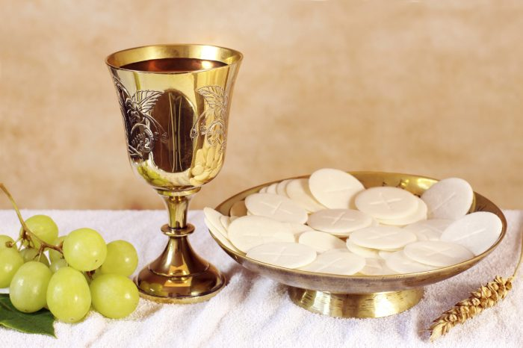

The Liturgy of The Eucharist

Slide 14
Pray, brethren, that my sacrifice and yours may be acceptable to God, the almighty Father.
May the Lord accept the sacrifice at your hands
for the praise and Glory of his name,
for our good
and the good of all his holy Church

Slide 15
Eucharistic Prayer
The Lord be with you.
And with your spirit.
Lift up your hearts.
We lift them up to the Lord.
Let us give thanks to the Lord our God.
It is right and just.

Slide 16


Slide 17
Holy, Holy, Holy
Lord God of hosts.
Heaven and earth are full of your glory.
Hosanna in the highest,
Blessed is he who comes in the name of the Lord,
Hosanna in the highest.

Slide 18
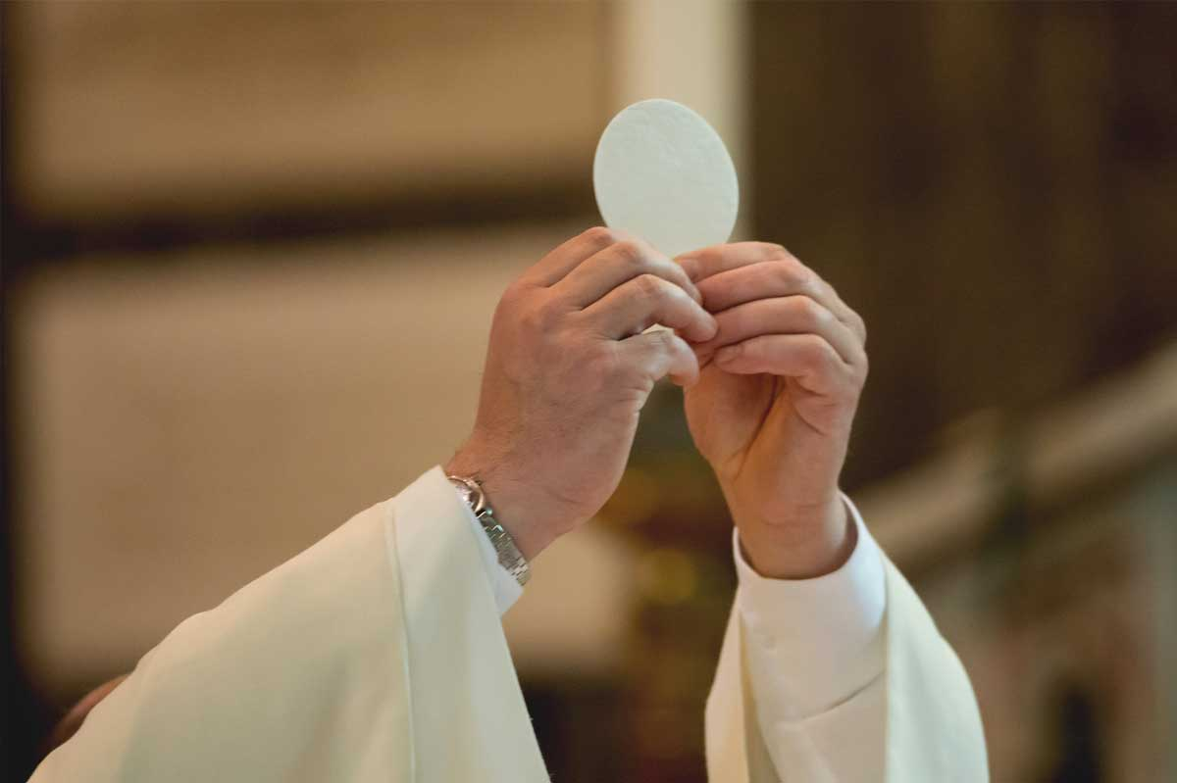

Slide 19
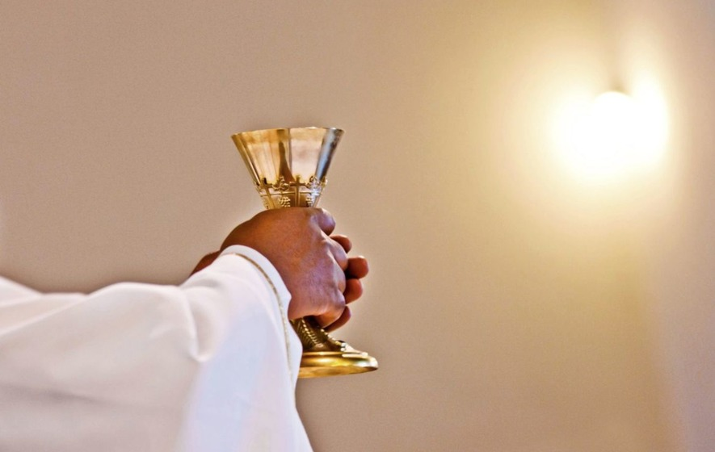

Slide 20
Mystery of Faith
Save us,
Saviour of the world
For by your cross and resurrection
You have set us free.
You are the Saviour of the world.

Slide 21
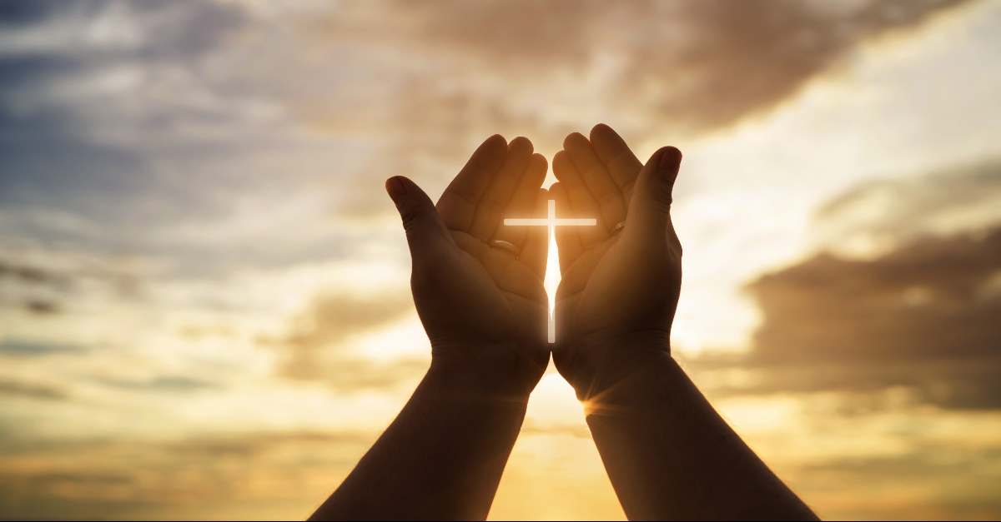
Response:
Glory to God in the Highest

Slide 22
Our Father
Our Father who art in heaven….
Deliver us, Lord, we pray, from every evil,
graciously grant peace in our days,
that, by the help of your mercy,
we may be always free from sin
and safe from all distress, as we await the blessed hope
and the coming of our Saviour, Jesus Christ.
For the kingdom,
the power and the glory are yours
now and forever. Amen.

Slide 23
Lamb of God you take away the sins of the world.
Have mercy on us.
Lamb of God you take away the sins of the world.
Have mercy on us.
Lamb of God you take away the sins of the world.
Grant us peace.

Slide 24
Behold the lamb of God,
Behold him who takes away the sins of the world.
Blessed are those called to the supper of the lamb.
Lord I am not worthy to receive you
But only say the word and my soul shall be healed.

Slide 25
Lord I am not worthy to receive you
But only say the word and my soul shall be healed.
Lord I am not worthy to receive you
But only say the word and our world shall be healed.

Slide 26
Communion Hymns:
This is my body, broken for you,
bringing you wholeness, making you free,
take it and eat it, and when you do,
do it in love for me.
This is my blood poured out for you,
bringing forgiveness, making you free.
Take it and drink it, and when you do,
do it in love for me.
Filled with my Spirit, how you will grow!
You are my branches; I am the tree.
If you are faithful, others will know
you are alive in me.
Love one another - I have loved you,
and I have shown you how to be free;
serve one another, and when you do,
do it in love for Me

Slide 27
Communion Hymns:
Communion Hymn: Taste and see
Taste and see
The goodness of the Lord (x5)
Come to Him, come to Him,
All who are hungry,
Come to Him, come to Him,
All who thirst.
I am your God,
You are my people.(x2)
Taste and see
The goodness of the Lord (x2)
I am the living bread,
I am the new wine,
Blessed, broken, poured out
Shared for all.(x2)

Slide 28
O Sacrament most Holy, O Sacrament Divine, all praise and all thanksgiving be every moment thine!
O Sacrament most Holy, O Sacrament Divine, all praise and all thanksgiving be every moment thine!
O Sacrament most Holy, O Sacrament Divine, all praise and all thanksgiving be every moment thine!

Slide 29
Prayer for Peace
Mary, Mother of God, Queen of the Universe.
We ask you to intercede for the people of war torn countries, for their governments, and all who suffer as a result of war.
Be with them as you stood beside your Son, suffering on the Cross and Calvary.
Give them strength and courage through faith, hope and justice. May we support them through prayer and generosity. That human lives may be saved. That the injured may be healed. That the dead may rest in peace. That there will be peace after war.
Amen

Slide 30
Diocesan Prayer for Vocations
Lord Jesus, send Labourers into your harvest. Inspire in the hearts of your people, vocations to the Priesthood, Diaconate, religious Life and married life. Bless our homes, our families, our parishes, our diocese, our countries with a spirit of generosity. May those whom you call to the Priesthood, Diaconate, religious life and married life have the courage to give themselves to your Church as co-operators in your work
St John Vianney: Pray for Us

Slide 31
Diocesan Vision Prayer
Spirit of God,
descend on me this day.
Grant me the spirit of joy, to lift me,
the spirit of hope to inspire me,
the spirit of love to surround me and
The spirit of truth to enlighten my path.
Holy Spirit,
I pray for a new outpouring of your grace,
So that I may grow in worship of your name
In love of you in my prayer
And in my actions towards others.
Come Holy Spirit into my life to guide me.
Strengthen and defend me,
so that I may be drawn ever closer to you.
Help me this day and always
to be a channel of grace
in all I say and do
and invite others into relationship with you.
Amen

Slide 32
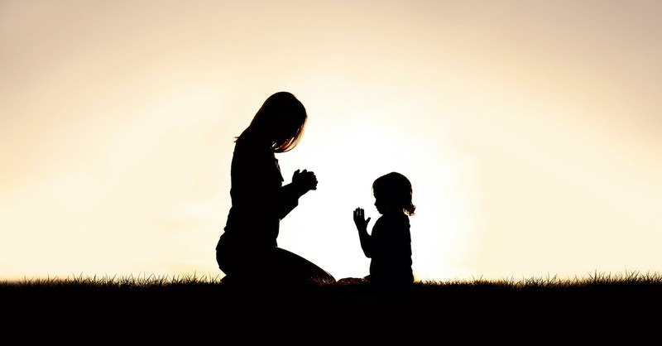

Slide 33
Go in peace to love and serve the Lord
Thanks be to God.

Slide 34
Go through the park, on into the town.
The sun still shines on, it never goes down.
The light of the world is risen again
The people of darkness are needing our friend.
So light up the fire and let the flame burn,
Open the door, let Jesus return.
Take seeds of his spirit, let the fruit grow.
Tell the people of Jesus, let his love show.
Recessional Hymn –
Colours of day dawn into the mind,
the sun has come up, the night is behind.
Go down in the city, into the street
And lets give the message to the people we meet.
So light up the fire and let the flame burn,
Open the door, let Jesus return.
Take seeds of his spirit, let the fruit grow.
Tell the people of Jesus, let his love show.

