Slide 1


Emotion Coaching an approach to support children to recognise and manage their emotions
St Edward’s Catholic Primary School
Isabel Gregson

Slide 2

Why are we here today?
To offer a space for connection and transparency
To highlight the journey St Edward’s is on to becoming an Attachment Aware & Trauma Informed School
To understand that behaviour is a form of communication
Recognising how we can respond to behaviours and emotions

Slide 3

TIAAS Principles
We see behaviour as a communication
We recognise that a sense of safety is the foundation of all learning and exploration
Relationships are prioritised in all that we do
We are curious about the experiences of families and what that means for them now
All emotions are recognised, and we offer empathy to all
We regulate before using reasoning and make space for reparation

Slide 4
Caveat
“Good Enough Parenting”
Developed by John Winnicott - (Paediatrician & Psychoanalyst in 1950s)
Notes:
Wanted to bring you..as parents on the journey with us…
We will be discussing today a range of styles of responding to emotions…at a given time we will all have used or responded in these different ways to children, friends or adults.
This is not to shame anyone for doing so

Slide 5

Understanding Behaviour as Communication
All behaviour is communication. What we see (behaviour) will be driven by what we don’t see (emotions).
Behaviour
Emotions
Notes:
Any behaviour can be likened to an iceberg, we see surface behaviour but there is lots we don’t see

Slide 6

Understanding Behaviour as Communication
Kicking
Shouting
Throwing things
Anger
Guilt
Sadness
Grief
Anxiety
Embarrassment
Shame
Helpless
Offended
Overwhelmed
Annoyed
Notes:
We might see kicking, shouting, throwing things, behaviours which make us think the child is angry
But there is complexity to behaviour. Behaviour is always communicating something. It may be communicating an underlying emotions, or complex emotions that the young person may not even be aware of
For example, Guilt
Sadness
Grief
Anxiety
Embarrassment
Shame
Helpless
Offended
Overwhelmed

Slide 7
Understanding Behaviour as Communication
Consider your child
What behaviour do you see and what emotions may be driving this?
Behaviour
Emotions
Notes:
Reflection activity
What behaviour do you see and what emotions may be driving this?

Slide 8

Changing our perspective on behaviour
The emotions a child experiences in response to a situation may be based on prior experiences and learning. We need to be curious about these experiences in order to better understand the emotions and subsequent behaviour.
What’s wrong with you?
What has happened to you?
How did it affect you?
What sense did you make of it?
What did you have to do to survive?
Notes:
“Towards the identification of patterns in emotional distress, unusual experiences and troubled or troubling behaviour, as an alternative to functional psychiatric diagnosis”
Replacing the question “What is wrong with you?” Which assumes a medical condition or character weakness
Let’s ask different questions
What happened to you?
How did you it affect you?
What did you have to do to survive?
What sense did you make of it?

Slide 9
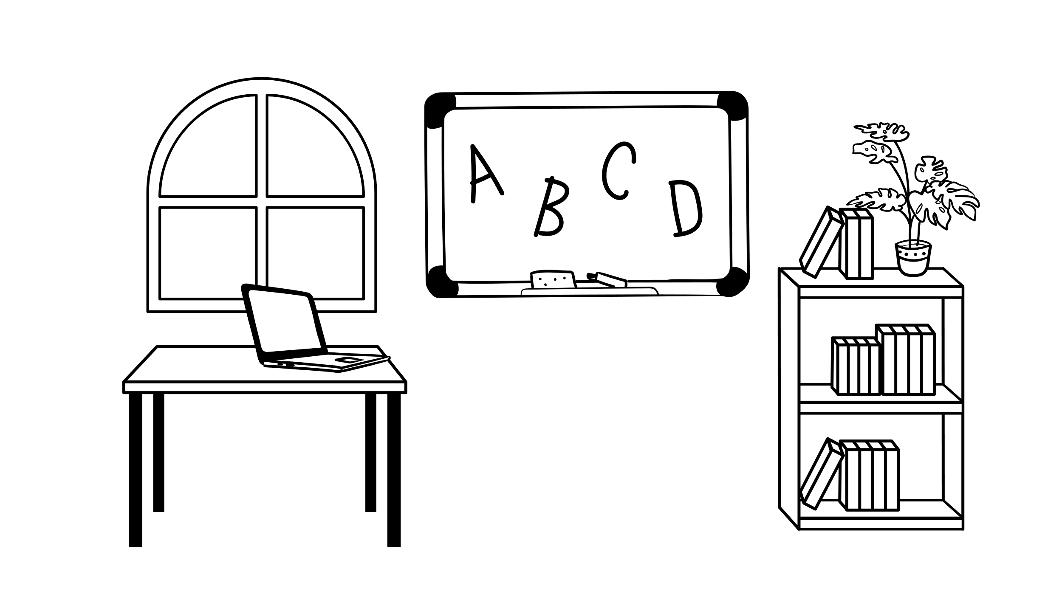
How do we tackle behaviour and emotions?
Emotion Disapproving
Emotion Dismissing
Laissez-Faire
Emotion Coaching
Notes:
There are different ways to tackle tricky behaviour and emotions when we are working with children.
We are going to explore the different styles in this section. We will be looking at
Emotion disapproving
Emotion dismissing
Laissez-faire
And emotion coaching
Just to say, we will all use these styles at times, although we are going to be looking at the limitations of the first three styles we want you to be assured that we all use them and we appreciate there are times where they are useful.
We are going to just be emphasising how where you can emotion coaching is a positive and useful approach to support children’s social and emotional development

Slide 10
Style 1
Emotion Disapproving
Disapproves of negative emotions – viewed as a sign of weakness, lack of control, unconstructive
Tries to get rid of negative emotions via discipline, reprimand, punishment
Focuses on the behaviour rather than the emotions generating the behaviour
Lacks empathy, noticeably critical and intolerant
More likely to view negative emotional displays as a form of manipulation, lack of obedience, sign of bad character
Often motivated by need to control and regain power and/or to ‘toughen up’ child
Notes:
Not focusing on the emotions, trying to get rid of the behaviour

Slide 11

What you might say if you are using an emotional disapproving style…
“Boys don’t cry!”
“Stop crying this instant”
“That is naughty stop that right now!”
“Don’t be so silly what are you crying about?”
“You are badly behaved”
“Stop whinging!”
Notes:
Here are some examples of what an adult might say if they are using an emotion disapproving style

Slide 12
Style 2
Emotion Dismissing
Despite good intentions (wants to make child feel better) is uncomfortable, fearful, anxious, hurt, annoyed or overwhelmed with negative emotions
Considers paying attention to such emotions will make them worse, prolong them
Wants negative emotions to go away quickly
Tries to stop negative emotions by reducing/ minimising/ making light of their importance, e.g. it’s no big deal, don’t worry about it, be a big girl, that’s life, you’ll be fine
Often motivated by need to rescue and make things better, fix the problem e.g. ‘have a biscuit’, ‘I’ll buy a new one’, ‘you need to do this’
Focuses on getting rid of the emotion with logic or distraction rather than understanding the feelings

Slide 13


What you might say if you are using an emotional dismissing style…
“There’s no need to worry about it”
“You’re fine, come on stop crying you’ll be okay”
“Have a biscuit you’ll be fine”
“Don’t be sad!”
“Have a drink and a calm down”
“What’s this silly crying all about, you’ll be ok”

Slide 14
The potential effects of a disapproving or disapproving style
If you use just these styles all the time…
The child does not learn to trust their feelings and this can affect their decision-making.
They are not given opportunities to experience emotions and deal with them effectively so they can grow up unprepared for life’s challenges.
It can lead to suppression of natural emotions and lack of practice of how to regulate unpleasant emotional experiences.
It can generate more negative feelings including resentment, guilt, shame and anger.
Notes:
The child’s feeling the emotion but no one is paying attention to them so they feel they are wrong and they will not trust their feelings. They will suppress their emotions because they feel they will only get ignored or shouted at. They then have to rely on adult co-regulation as they are unable to self regulate because they haven’t learned these strategies. It can then lead to resentment and further negative feelings.

Slide 15

Style 4
Emotion Coaching
Teaching children about the world of emotion ‘in the moment’
Giving children strategies to deal with ups and downs
Accepting negative emotions as normal
Using moments of negative behaviour as opportunities for teaching
Building trusting and respectful relationships with children
Notes:
Emotion coaching is about:
Teaching children about the world of emotion ‘in the moment’
Giving children strategies to deal with ups and downs
Accepting negative emotions as normal
Using moments of negative behaviour as opportunities for teaching
Building trusting and respectful relationships with children

Slide 16
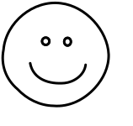
Sanctions and Rewards V Emotion Coaching
Sanctions and Rewards
External frameworks
External regulation
Emotion Coaching
Internal frameworks
Internal regulation
Notes:
Sanctions and rewards only promote development if the child’s thinking stage has sufficiently developed so that they understand cause and effect. If the child’s thinking stage isn’t sufficiently developed punitive systems will not work and will not generalise into wider contexts. Internal frameworks will promote development and will stay with them throughout their lifetime..

Slide 17
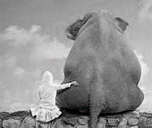
How to Emotion Coach
Step 1
Recognise the child’s feelings and Empathise with them
Step 2
Validate the feelings and label them for the child to help them to understand
Step 3
Set limits on their behaviour (if needed)
Step 4
Problem-solve with the child
Notes:
Get to know the child and understand their behaviours as these are the way in which they are communicating their emotions. Also recognise emotional times as opportunities for intimacy and teaching. When you name the feeling you tame the feeling. Studies have show just by naming the feeling calms the nervous system
Be aware of child’s responses, listen empathetically
Validate child’s feelings and help child to verbally label emotions – helps sooth the nervous system and promote recovery rate
Set limits while helping child to problem-solve
Once the child has flipped their lid there isn’t much you can do other than to soothe. If you can see the child is becoming dysregulated more and more then this is the time to emotion coach.
Don’t attempt the steps until their arousal levels are lowered. Complete 1 and 2 in the heat of the moment and ensure most time is spent on these steps.

Slide 18
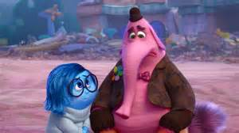
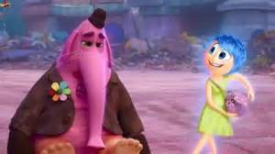

Identify the Emotion Coach
Is it Sadness?
Or is it Joy?
Notes:
Compare Sadness and Joy in the following clip...
Who is emotion coaching and who is emotion dismissing and why?

Slide 19
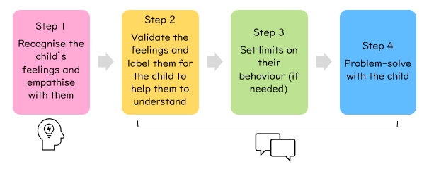
Recap
Notes:
Get to know the child and understand their behaviours as these are the way in which they are communicating their emotions. Also recognise emotional times as opportunities for intimacy and teaching. When you name the feeling you tame the feeling. Studies have show just by naming the feeling calms the nervous system
Be aware of child’s responses, listen empathetically
Validate child’s feelings and help child to verbally label emotions – helps sooth the nervous system and promote recovery rate
Set limits while helping child to problem-solve
Once the child has flipped their lid there isn’t much you can do other than to soothe. If you can see the child is becoming dysregulated more and more then this is the time to emotion coach.
Don’t attempt the steps until their arousal levels are lowered. Complete 1 and 2 in the heat of the moment and ensure most time is spent on these steps.

Slide 20
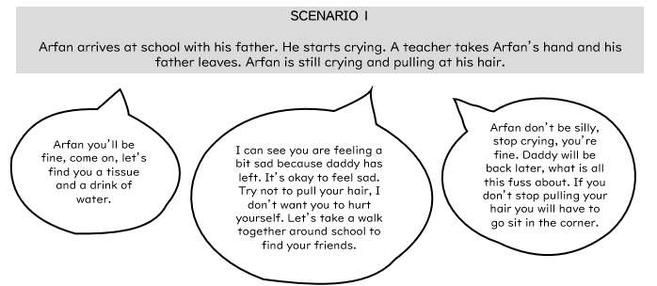
What style is being used?
Notes:
Activity
Read scenario
Read responses
Ask audience to mark which style is which in their handout booklet
Pick from 4

Slide 21
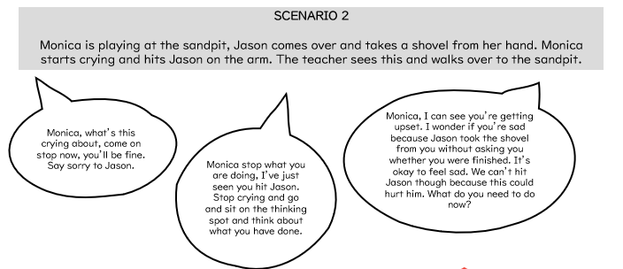
What style is being used?
Notes:
Activity
Read scenario
Read responses
Ask audience to mark which style is which in their handout booklet

Slide 22
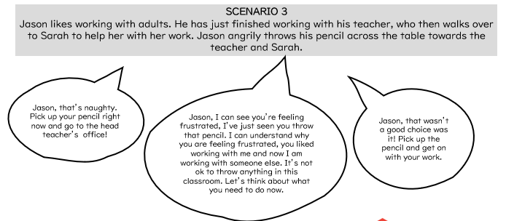
What style is being used?

Slide 23
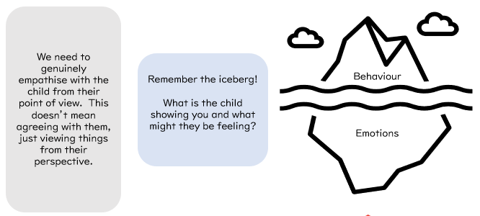
Step 1 – recognise the emotion and empathise with it
Notes:
We need to recognise that all emotions are natural and normal and are not always a matter of choice
Remember that behaviour is communication
Empathy is difficult as you genuinely need to connect and show empathy with the child – this is why there is a need for a good relationship with the child and therefore a good connection.
Wondering aloud techniques can be used to voice the potential communication the child is trying to give through their behaviour.
Smiling response activates the vagal nerve which may explain children giving this response inappropriately. Can also be used to cover up the child’s shame or embarrassment.
Name it to tame it

Slide 24
Empathy
Empathy
Viewing the situation from the child’s perspective
Is not agreeing with the child’s behaviour
Recognises that all emotions are normal and natural
Recognises that behaviour is communicative
Is feeling with the young person
Is being attuned to a child’s emotional state
Is feeling and showing appropriate concern
Notes:
Empathy is…
Recognising that behaviour is communication of an underlying emotion (think about the iceburg)
Recognises that all emotions are normal and natural
Is being attuned to the child’s emotional state
Is feeling and showing appropriate concern
Is viewing the situation from the child’s perspective
Is feeling with the young person

Slide 25
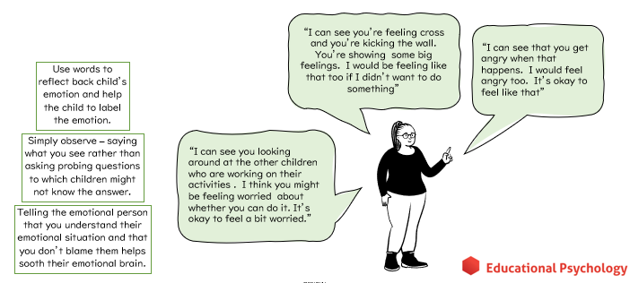
Step 2 – validate and label the emotion
Notes:
Some top tips
Acknowledge low levels of emotion before they escalate to full-blown crisis.
Acknowledge all emotions as being natural and normal and not always a matter of choice.
Recognise behaviour as communicative (relational not behavioural model).
Demonstrating empathy when stakes
are low creates a good foundation.
Becoming the child’s ally.
Read out some of the examples

Slide 26
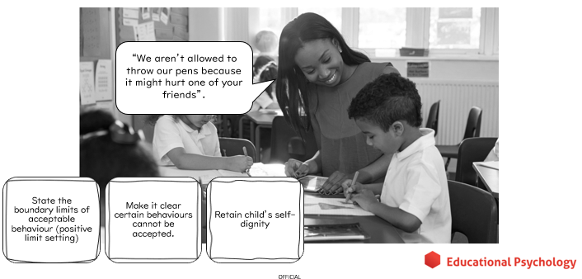
Step 3 – set limits on the behaviour
Notes:
Boundaries regarding behaviour are needed, they represent the lawful society we live in and can also help children to feel secure and safe
Set boundaries but
Do not do it in a way that will embarrass the child or which will invalidate the connection you have made during the first couple of steps of emotion coaching
Avoid using the word ‘but’

Slide 27
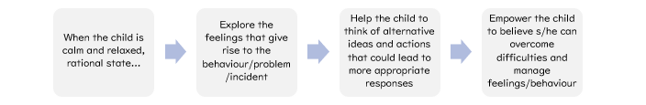
Step 4 – problem solve with the child
Notes:
Majority of the time children don’t like what they do when they dysregulate but they can not help it – they want help to manage their emotions and resulting behaviour

Slide 28
Finding Solutions - examples
“What does your body feel like now?”
“What feelings are you having?”
“Let’s think of what we could have done instead”
“Can you think of a different way to deal with your feelings?”
“I can help you to think of a different way to cope”
“Can you remember what we said before?”
“Let’s sort this out”
“Try and do this next time you feel like this”
“Let’s decide what you will do next time you feel like this”
“This is what you can do instead”
“What might your friend do or suggest you do?”

Slide 29
Considerations
Step 1- Recognise and empathise
Step 2- Label and Validate
Emotion picture cards
Step 3- Set Limits
Step 4- Problem Solve
Photographs
Modelling
Self-modelling with photographs or video
Choices which may be presented tangibly with objects of reference or other visuals
Drawing alternative scenarios
Makaton (e.g. finished)
Puppets or soft toys
Role play and imaginative play
Visual behaviour reminders
What ideas do you have for how you can successfully emotion coach children who may struggle with understanding and using language? Or younger children? Or within your home?
Notes:
Of course very young children may lack the receptive and expressive communication skills to be able to engage in emotion coaching conversations
Want to spend some time thinking about how we can differentiate this approach to make it work for young children who may lack language skills
Here are some examples of things you might try at each stage
For example, using emotion picture cards when labelling the emotions or visual behaviour reminders
Using play to problem solve
Discussion activity- What ideas do you have for how you can successfully emotion coach with young children who may lack developed language skills?

Slide 30
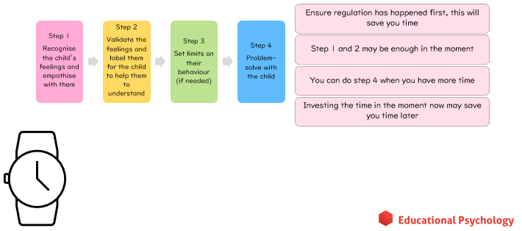
Further considerations

Slide 31
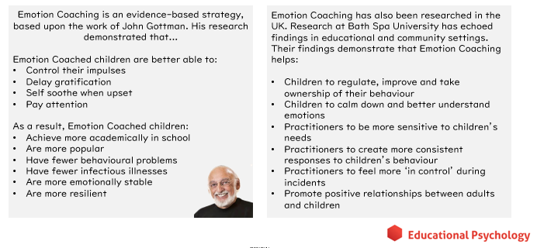
Why we love emotion coaching
Notes:
1986 – 56 married couples with children aged 4 -5 years at that time. Looking at parent’s marriage, their reactions to children’s emotional experiences, kids peer relationships & family’s ideas about emotion (role emotion plays in their lives). 3 years later checked to see whether parents were still together and happy in their marriage but also how the children were.
They found children whose parents were emotion coaches (guide their children about the world of emotion):
Better academic performance (controlling for IQ had higher maths & reading scores)
Better social competence (getting along better with friends, fewer negative & more positive emotions, stronger social skills)
Better emotional well-being (less stress related hormones in urine & lower resting heart rate)
Better physical health (fewer infectious illnesses)
Longer term – the child becomes more resilient. They are better able to soothe themselves, bounce back from distress and continue with productive activities.
Emotion coaching wasn’t something that was experimented with it was found. This was in the states – it’s now moved to the UK where universities are conducting research on it
(For further research into emotion coaching effectiveness see reading on ‘evaluations of emotion coaching’ on s-drive)
Practitioners feel more in control because they know what to do and how to deal with the situation

Slide 32
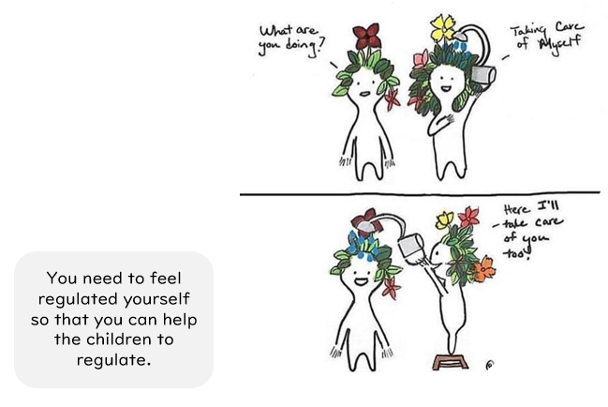
Self Regulation

Slide 33

Thank you ☺
Emotion Coaching Resources for Professionals

Slide 34


