Slide 1
Food and food packaging waste
Assembly
Notes:
This is an assembly about waste associated with food and its packaging.
You can use these slides to discuss the topic with students and/or to launch your Waste Week campaign.

Slide 2
How to use this presentation
The Pod starter presentations have been designed in PowerPoint so you can edit them for your own purposes. For example, removing any slides to cut down the presentation or adding in any to personalise it to your school or group.
The presentation can be led by students (e.g. the Eco Club) or teachers.
We have suggested the use of props on some slides, but this is optional.
There are notes at the bottom of each slide for teachers to read – click the View tab and ‘Normal’ if you can’t see these.
Where italics are used in the notes section, this denotes notes for teachers (e.g. where to find additional resources on the Pod).
You can find additional information to support this presentation at www.jointhepod.org/waste-week-resources
At the end of the presentation (slide 19 onwards) there are some extra slides you can use to create a closing assembly to update the school on what the school did during Waste Week. If you don’t need these, you can remove them.

Slide 3
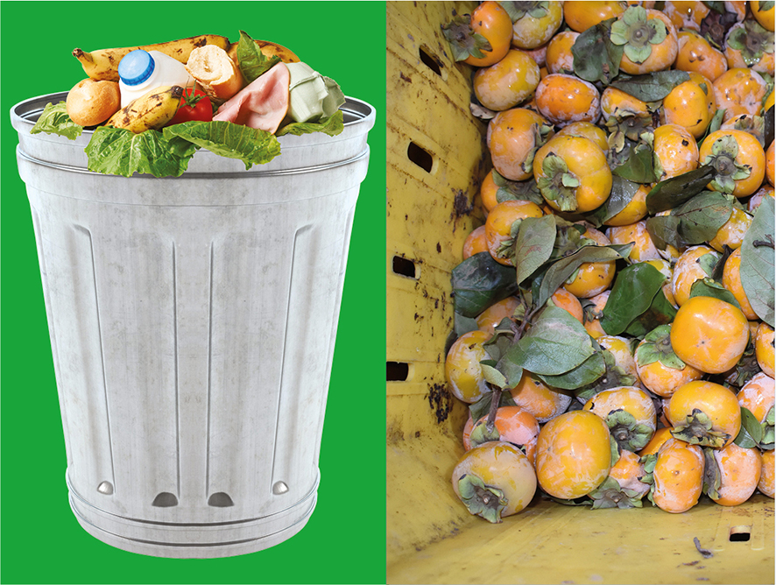
Notes:
Food waste is a BIG problem. In fact, one-third of the food grown in the world is thrown away¹. Can you imagine how big that pile of food would be?
Why do you think so much gets thrown away?
Ask students to raise their hands or shout out answers.
The reasons why food is thrown away depends on whether you live in the DEVELOPED world – countries like the UK – or the DEVELOPING world – countries like India.
In the DEVELOPED world, food waste is usually caused by us buying or cooking too much, so we end up throwing it in the bin uneaten [point to the lefthand picture of the bin].
But in the DEVELOPING world, this type of waste is the reason for only a small amount of food being thrown away; the majority of food waste occurs before it even reaches the shops or people’s homes! Either because it’s not stored properly or it gets damaged in transit, like these persimmons [point to the picture on the right].
Sources:
¹ http://www.fao.org/save-food/resources/keyfindings/en/

Slide 4
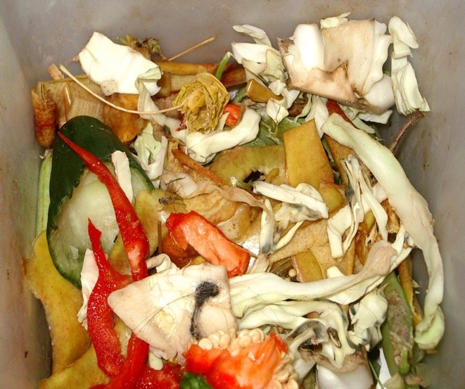
Throwing away food at home
4.4 million tonnes of ‘avoidable’ food is thrown away from our homes every year…
…This is food which could have been eaten!
Notes:
Ask students to raise their hands to the following question:
Do you ever throw away food?
Then ask: Why? Ask them to raise their hands or shout out their responses.
There are two reasons why we usually throw away good food:
1) We cook or prepare too much;
2) Or, we don't use it in time.
Ask students:
Where do you think the food goes that we throw in the bin? What happens to it?
Source for stat on slide: http://www.wrap.org.uk/content/all-sectors
Image: Biodegradable_waste.jpg
Wiki commons

Slide 5
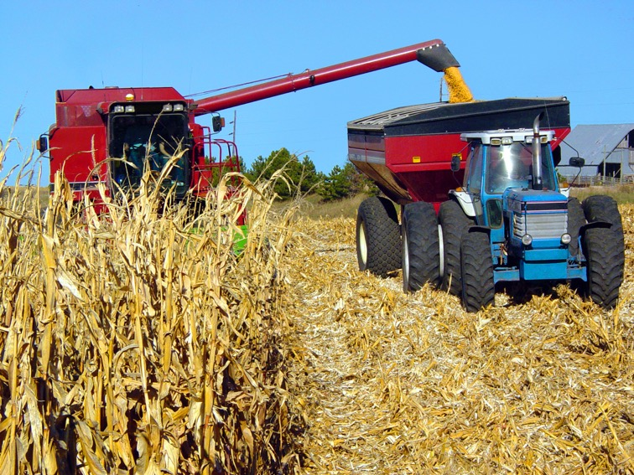
Waste and greenhouse gases
10% of greenhouse gas emissions from rich countries comes from growing food that is never eaten.
Notes:
Food that goes in the rubbish bin usually ends up in landfill (a big hole in the ground filled with other rubbish) or it gets burned (some councils burn waste instead of putting it in landfill). Either way, it’s a waste of resources. Energy, land, water and food is used to make, grow and harvest food; this is all for nothing when the food that’s produced ends up in the bin.
Also, resources are used to collect rubbish – think of the people you see collecting waste, the trucks that are required and so on.
Food which ends up in landfill doesn’t decompose in the same way it might in the compost heap either. Instead it lets off a greenhouse gas that contributes to climate change called methane. This isn’t good for the environment.
Source for stat on slide: https://www.tristramstuart.co.uk/food-waste-facts/

Slide 6

Food for everyone in the world
Notes:
By 2050 – when you’ll all be middle aged and have children of your own! – the amount of food we produce to feed everyone on the planet will need to have increased by 60% in order to feed an extra 2 billion people living on the planet². That’s a lot of extra mouths to feed!
But one of the ways in which we can ensure we have enough food in the future – and relieve pressure on resources, like land, energy and water – is to reduce the amount of food we throw away unnecessarily.
Even now, the United Nations estimates that if the amount of food lost or wasted around the world were reduced by just 25% there would be enough food to feed all the people who are malnourished³.
The good news is if we all make little changes – not putting so much food on our plates, for instance – together, these little steps can make a big difference in reducing our overall food waste.
Now, can you guess which three food and drink items we currently throw away the most of in the UK?
You could ask students to raise their hands or shout out possible answers.
Sources:
² https://www.theguardian.com/environment/2015/aug/12/cutting-food-waste-enough-for-everyone-says-un
³ http://www.fao.org/save-food/resources/keyfindings/en/
Image: 6791773939_1dbb538d2f_o.jpg (https://www.flickr.com/photos/fmsc/6791773939)

Slide 7
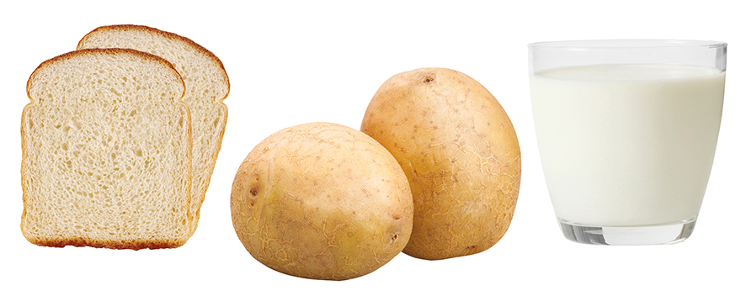
Notes:
[You could use props at this stage and have on the table a selection of food and drink items, including bread, potatoes and milk.]
The answers are bread, potatoes and milk. But can you guess how many of each are thrown away every day?
How many slices of bread, do you think?
1 million?
5 million?
15 million?
And what about potatoes…
10,000?
20,000?
100,000?
Or glasses of milk?
1 million?
2 million?
3 million?

Slide 8
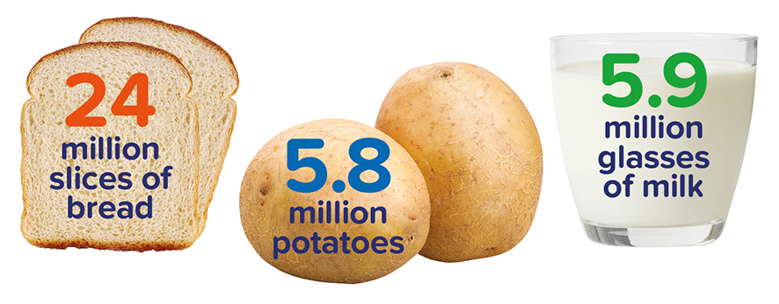
Notes:
In fact, you might be shocked to realise it’s much more than that!
EVERY DAY in the UK we throw away 24 million slices of bread, 5.8 million potatoes and 5.9 million glasses of milk⁴.
[Point to the bread, potatoes and milk] That’s a lot of each of these!
It’s a shocking amount of waste - and it’s usually because we haven’t used it up in time or we bought too much in the first place.
Sources:
⁴ http://www.wrap.org.uk/content/use-your-loaf-and-save-billions

Slide 9
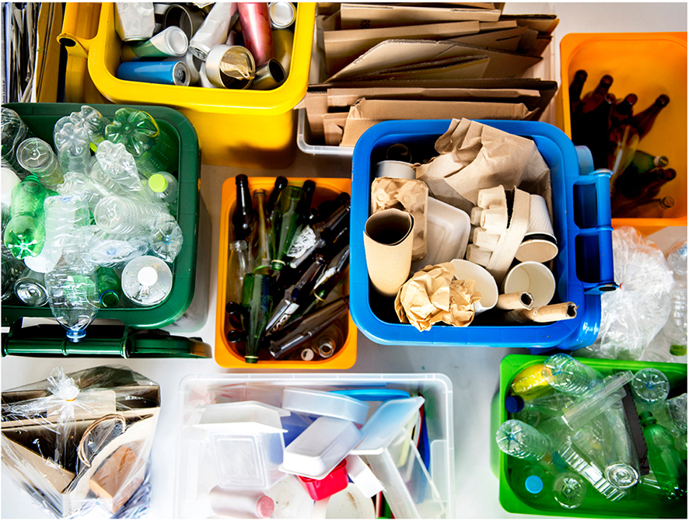
Notes:
But it’s not just food that we waste every day… We also throw away a lot of food packaging.

Slide 10
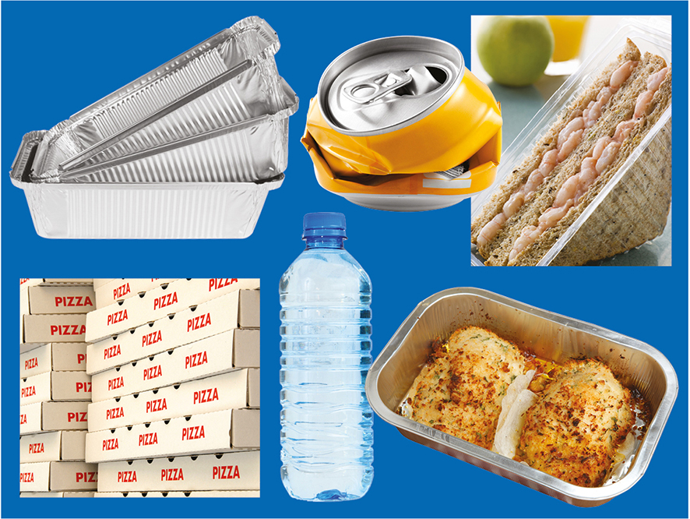
Notes:
[At this point, you could produce some props - different types of food packaging]
Ask students to answer the following questions:
Do you recognise any of these?
What do you do with them when they’re empty?
Do you know which of these items can be recycled?
Do you ever reuse any of these things?
Did you know… . The average person in the UK gets through 90 drink cans, 70 food cans, 107 bottles and jars and 45kg of plastic a year. That’s a lot of packaging!⁵
Sources:
⁵ http://www.recycling-guide.org.uk/facts.html

Slide 11
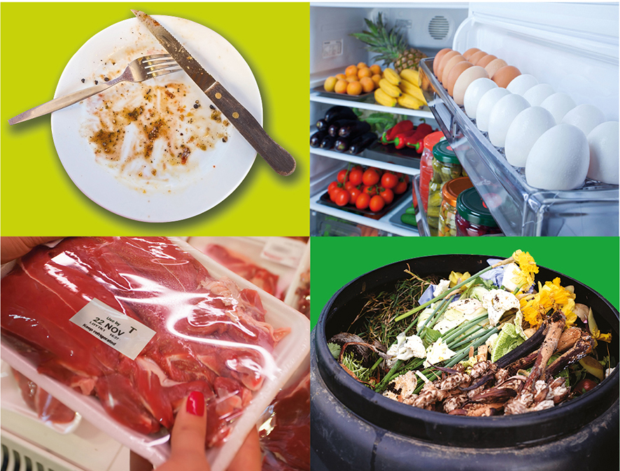
Notes:
BUT the good news is we can do something about all this waste!
Can you guess some of the things you could try at home to reduce food waste?
Encourage students to raise their hands or shout out answers when you point to each of the pictures.
From top left, clockwise:
Only serve up what you think you can eat – you can always have seconds!
Make sure that food is stored correctly in the fridge – look out for a little blue fridge icon on food as this means that food needs to be stored in the fridge below 5ºC.
3) Do you know the difference between these three: use by date / best before date / display until date? [You could turn this into a mini quiz, if time – see below]
4) Compost waste, wherever possible. You can compost more than you think [take a look at the Pod’s compost game: https://jointhepod.org/teachers/activities/compost-quick-activity]
The use by date is the date which you need to eat the food by; it is NOT safe to eat it past this date as it could make you unwell (even if it looks and smells ok).
The best before date is the date which the manufacturer recommends you eat the food by; it is still safe to eat past this date but it might not be at its freshest or tastiest.
The display until date is of no importance to you or me! It’s simply to let the shop know what date they should display the food on the shelves until.

Slide 12
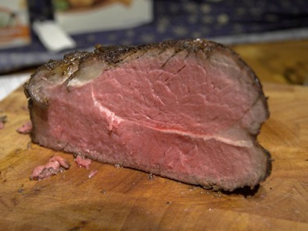

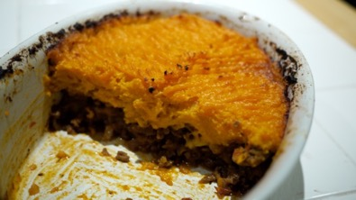
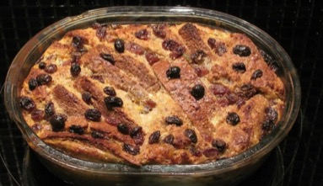
Some of the best food
comes from leftovers
Roast beef becomes
cottage pie
Bread becomes
bread and butter pudding
Notes:
Do you eat leftovers at home?
You might have done so without even realising! Eating leftovers in new dishes is another great way of avoiding food waste.
Other questions to ask students:
Does your family have a favourite recipe that uses leftovers?
How about making a recipe book and encouraging others not to waste food, you could give tips on storage and sell by dates. You could even sell it and raise money for your school.
Image: Roast_beef.jpg (http://de.wikipedia.org/wiki/Roastbeef), Cottage.jpg (https://www.flickr.com/photos/ivanlian/6848705935)
Image: Bread.jpg (http://www.freefoto.com/preview/09-03-2/Sliced-Loaf)
Pudding.jpg (http://en.wikipedia.org/wiki/Bread_and_butter_pudding)

Slide 13
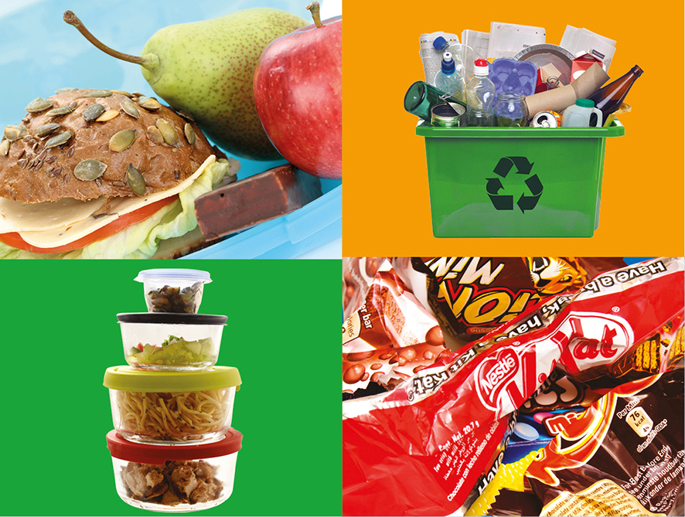
Notes:
There are lots of things you can do to reduce packaging waste at home too.
Looking at the pictures, can you guess what some of these solutions might be? [Ask students to raise their hands or shout out answers to what they think each of these pictures might represent]
From top left, clockwise:
How waste-free is your packed lunch? What could you change? [Discuss possible alternatives]
Do you recycle as much packaging as possible? Do you know what your local council will collect? Or places nearby, where you can take hard-to-recycle items, like biscuit wrappers?
Do you use reusable containers? They’re great for transporting leftovers and mean you can avoid using plastic wrap or foil.
Think how many single-use items you have at home – can you think of ways of reducing this? For instance, instead of buying individually wrapped biscuits, could your family buy a big pack and use reusable containers to pack a couple for school? The same applies to cheese, breadsticks… pretty much most things you might bring into school!

Slide 14
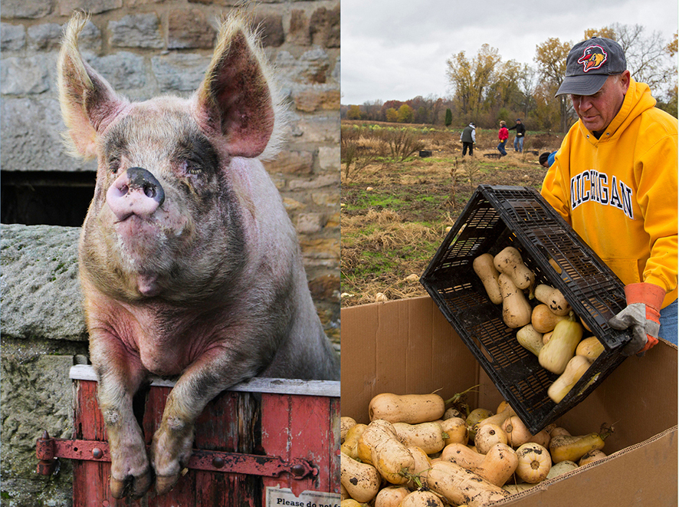
Organisations helping
to eliminate food waste
Notes:
Lots of organisations are also trying to tackle the problem of food waste…
[Point to the picture on the left] The charity Feedback has a campaign called The Pig Idea to try and lift the EU ban on feeding catering waste (otherwise known as ‘swill’) to pigs. For thousands of years pigs have been mankind’s perfect partner: they consume waste and convert it back into food, (i.e. pork). But following the outbreak of Foot and Mouth and its devastating consequences on British farming in 2001, the government introduced a ban on feeding catering waste to pigs.
[Point to the picture on the right] Have you heard of gleaning? It’s the collecting and distributing of fruit and vegetables that would otherwise be unpicked and left to rot (farmers might have had an over-supply for example). Gleaning Networks coordinate volunteers, farmers and food redistribution charities to collect up these unwanted fruit and vegetables, and redistribute them to people who are hungry.

Slide 15
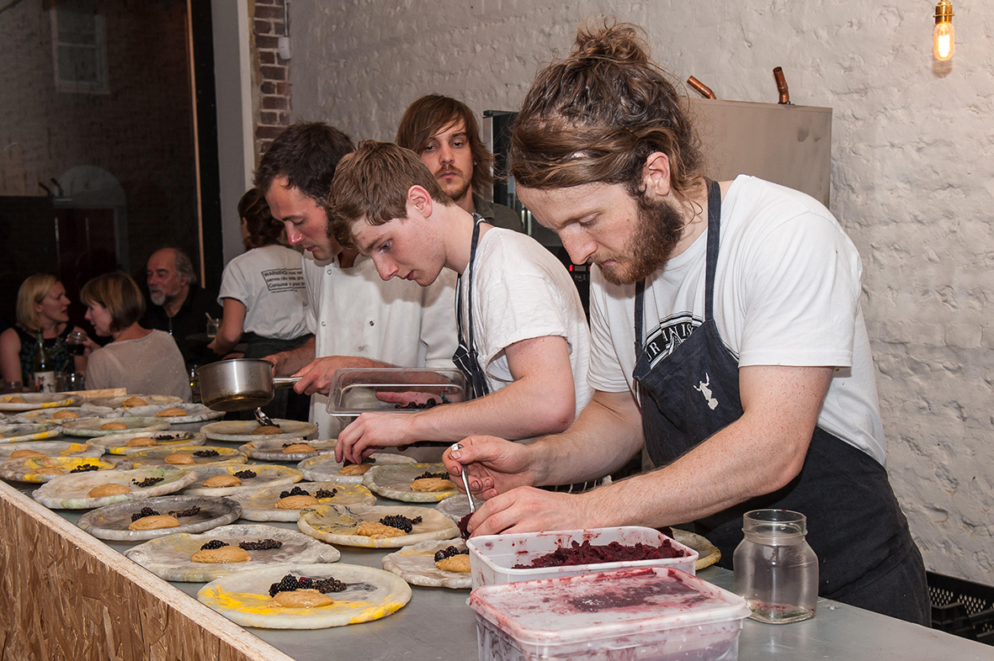
Making use of unwanted food
Notes:
Restaurants and cafes are also joining in…
Silo [pictured] is a restaurant in Brighton that doesn’t produce any waste; the furniture is upcycled, food is used in its entirety and any leftovers are fed into the aerobic digester.
Similarly, in Leeds, a restaurant called the Real Junkfood Project only serves meals created from food that’s going to be thrown away.

Slide 16
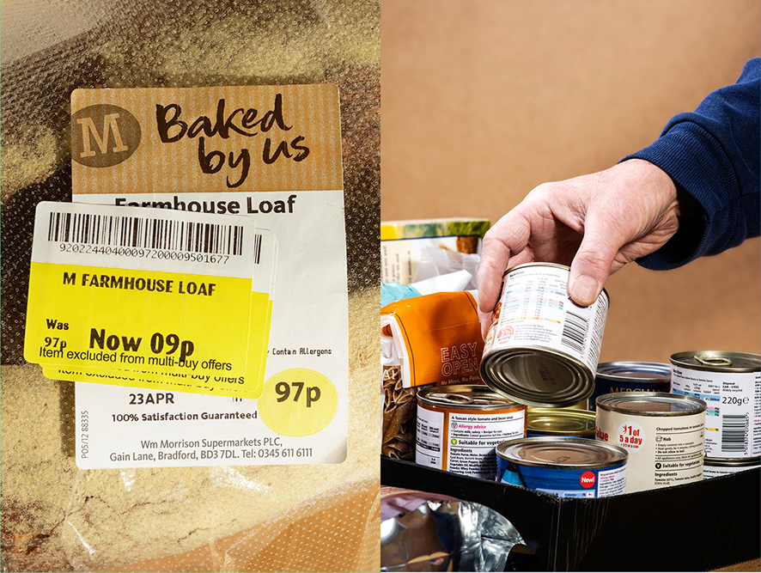
Notes:
Companies and charities are also trying to address the problem of food packaging…
[Point to the picture on the left] Who’s heard of the supermarkets Morrisons or Coop? [Ask for a show of hands]
Did you know that Morrisons gives away all its unsold food at the end of each day to food charities?⁶
In its East of England branches, Coop sells dried and tinned food past its best before date for an extra month, for only 10p a item⁷.
And in Cornwall, a supermarket selling products nearing their sell-by date or that have been rejected by supermarkets (because the packaging might be damaged, for example) for 25p each is opening more branches, after it proved so popular with shoppers⁸!
[Point to the picture on the right] Charities such as FareShare take unused food from manufacturers and supermarkets and give it to foodbanks and people who need it most. In 2016, FareShare redistributed the equivalent of 28.6 million meals for hungry people⁹.
Sources:
⁶ http://www.telegraph.co.uk/news/uknews/11968491/Morrisons-to-donate-all-unwanted-food-to-charity.html
⁷ https://www.theguardian.com/environment/2017/dec/04/retailer-to-sell-food-past-its-best-before-date-in-bid-to-cut-waste
⁸ http://www.telegraph.co.uk/finance/newsbysector/retailandconsumer/11956452/Bargain-Brand-Food-Outlet-Social-supermarket-for-25p-tackles-food-crisis.html
⁹ http://fareshare.org.uk/wp-content/uploads/2017/10/MEDIA-PACK-FareShare-Media-Information-2017.pdf

Slide 17
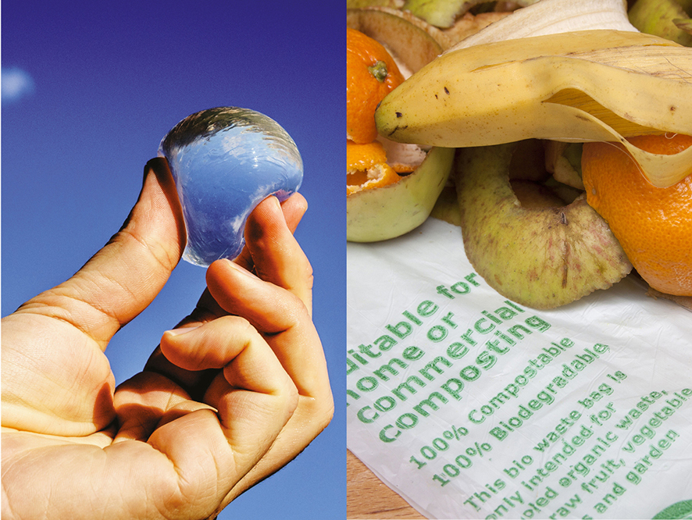
Notes:
And some manufacturers have come up with new, more environmentally-friendly types of packaging.
[Point to the image on the left] Would you ‘drink’ this edible water bottle? It’s made of natural plant and seaweed materials¹⁰.
[Point to the image on the right] Compostable packaging is also a new innovation. It looks like the traditional plastic bags you use for carrying loose fruit or veg you pick up at the supermarket, but these non-plastic bags can be put on the compost heap, as they break down naturally (plastic doesn’t).
Like all innovations though, these new packaging inventions have their downsides too… For instance, some biodegradable plastics only decompose in certain conditions (they wouldn’t break down in landfill, for example). So make sure you’re clear how you can dispose of any packaging you use!
Source:
¹⁰ http://www.skippingrockslab.com

Slide 18
Notes:
So who’s up for a challenge? Do you think you can reduce the amount of food or packaging you throw away?
We’re going to be joining in Waste Week on [insert dates] and finding out what we can do to reduce waste.
Join in and see what impact you can have. There are lots of ways to get involved at school… [List some of the things you might be doing during Waste Week e.g.]
Look out for Waste Detectives monitoring how much food waste and packaging is produced at lunch and snack times
Look out for posters with lots of facts about waste
You might be learning about it as part of your topic this term – there are some exciting Maths and Design and Technology activities
Younger children might be taking part in an undercover Mission Bin Possible exercise
We’ll be displaying a different waste fact each day on TVs around school
We’ll be playing a hide-and-seek game to find waste facts
We’ll be running a waste audit at home to try and reduce packaging waste produced here too, and sharing ideas for waste-free packed lunches and ideas for leftover dishes with families
We’ll be taking the waste audit on the Pod to track whether we reduce the amount of waste we produce as a result of Waste Week
To find out more about Waste Week, speak to [insert name of teacher or leader coordinating the school’s activities.]

Slide 19
Closing assembly
Notes:
Use slides 19-21 if you want to run a follow-up assembly to let the school know how effective your Waste Week campaign was, or what activities the school did.

Slide 20
Our Waste Week campaign
We took part in Waste Week on [insert dates]
The campaign was led by [insert names e.g. Eco Club or class] and [insert number of] children took part
More than [insert number of] schools joined in with us!
We collected [insert amount of waste collected e.g. 6 bags of rubbish] at the start of the campaign.
By the end of our campaign, we had reduced our waste by [insert figure from the waste audit]
Notes:
Give details of your school’s campaign using the suggested prompts on the slide or add your own.
You can find the latest stats for the numbers of schools that took part on the Pod at https://jointhepod.org/about/stats.
Find the waste audit at https://jointhepod.org/waste-week-audit.You’ll need to input two sets of data (before and after your campaign) for the audit to calculate automatically any savings you might have made.

Slide 21
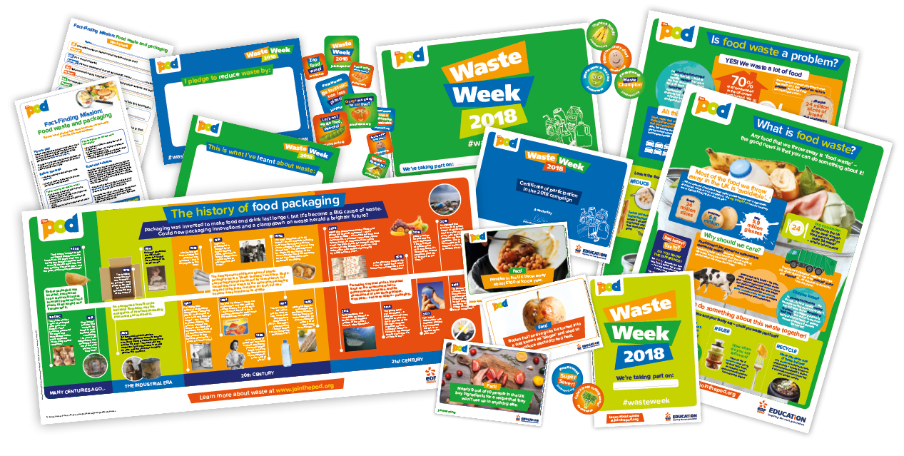
What we discovered
Notes:
Use this slide to talk about what students learnt or did during Waste Week. You could replace the image of the pack contents with photos of any work that the students produced to support their learning.

Slide 22
Notes:
You can find more waste resources at www.jointhepod.org/waste-week-resources

