Slide 1






Launch assembly
Notes:
This presentation is about the importance of saving energy. It can be used to launch your Switch Off Fortnight activities or the start of a lesson if you’re studying the energy topic.
There is a second assembly you can use at the end of Switch Off Fortnight (Closing Switch Off Fortnight Assembly: http://jointhepod.org/sofclosingassembly), which has ideas for how you can celebrate your school’s energy-saving achievements, reward students for taking part and continue to promote the energy-saving message to students and their families.
The assembly requires a few optional props, so make sure you’ve prepared in advance by collating all the materials together.

Slide 2


How to use this presentation
The Pod starter presentations have been designed in PowerPoint so you can edit them for your own purposes. For example, remove any slides that aren’t relevant to your students and add in any information that is.
The presentation can be led by students (e.g. the Eco Club) or teachers.
There is the option to include props in this assembly (see the notes section on individual slides, for details).
There are notes at the bottom of the assembly for teachers to read – click the View tab and ‘Normal’ if you can’t see these.
Where italics are used in the notes section, these provide supporting notes for teachers (e.g. ideas on what to mention to the students at this point in the presentation).

Slide 3

Notes:
Pre-assembly prep: If it’s possible, draw all the curtains in the room, so it’s dark. Then begin the assembly by turning all the lights off.
Ask the students: Why do you think we’ve turned the lights off?
Encourage them to put up their hands or shout out answers.

Slide 4
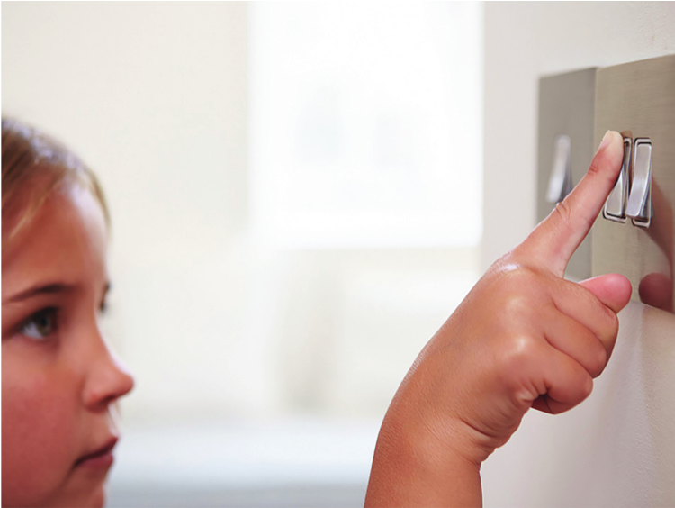
Notes:
That’s right – having the lights on uses electricity.

Slide 5

Notes:
Besides turning on lights, what else do we use electricity for?
Encourage students to put up their hands or shout out answers – you could also ask them why different activities use electricity (e.g. why does having a shower or bath use electricity? Answer: to heat the water.) Use the images on the slide to prompt responses from students:
Heating
We use electricity or gas to keep us warm at home and in school.
Hot water
We use electricity or gas to heat up hot water for taps, showers and baths.
Entertainment
Watching TV, playing on your games console, charging your mobile phone… If it requires a plug, it’s using electricity.
Kitchen
Cooking food – whether that’s in the oven, on the hob or in the microwave – uses electricity or gas. So does keeping food cold in the fridge or freezer… Making a cup of tea… Mixing up a smoothie… Baking cakes… Washing up. We use lots of electricity and gas in the kitchen!

Slide 6


Notes:
Using electricity and gas costs money, and has an impact on our planet.
That’s because the more electricity and gas we use, the more electricity and gas we need to produce – and this contributes to climate change.
If you want to explore the climate change angle in more detail with students, you could add in slides from the Energy assembly (http://jointhepod.org/energyassembly)
So what can we do about it?
Encourage students to put up their hands or shout out suggestions. The following three optional slides can be used as prompts if necessary.

Slide 7

Notes:
Never turn on the lights?

Slide 8
Notes:
Never use any power?

Slide 9

Notes:
Take cold showers? Never turn the heating on?

Slide 10


Stop wasting energy!
Notes:
You don’t have to stop using electricity or turn off the heating – but we could all be smarter about how we use it and not waste it.
So what can we do to stop wasting energy?
Encourage students to put up their hands or shout out suggestions. The following five optional slides can be used as prompts if necessary.

Slide 11

Notes:
Time to use a prop (optional): put on a thick jumper.
If you’re feeling cold, don’t rush to turn up the heating. What could you do instead?
Encourage students to put up their hands or shout out suggestions.
Put on a jumper
Close any open windows or doors
Many homes are actually too warm – ideally they should be heated between 18ºC and 21ºC. And, in fact, young people are more comfortable in lower temperatures than adults, so you have no excuse for turning up the heating!
Remember to tell your families about this too.

Slide 12
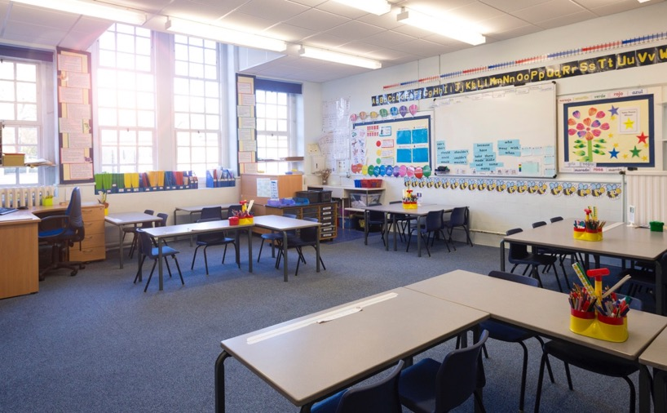
Notes:
Time to use a prop (optional): turn off the lights in the hall again.
You don’t have to live in constant darkness to save energy. What could you do instead?
Encourage students to put up their hands or shout out suggestions.
Turn off the lights when you leave a room
Make sure nobody else has left the lights on in an empty room
Make sure you’re using energy efficient lightbulbs.
Even turning off the lights for a moment saves more power than it does to start them up again, so always switch off the lights when you leave a room.
Remember to do the same at home too!
Time to use a prop (optional): show an energy-efficient lightbulb and a traditional style lightbulb (if available).
Also, check that your family aren’t using any old style lightbulbs too, as these waste energy more than newer style energy-efficient lights.

Slide 13
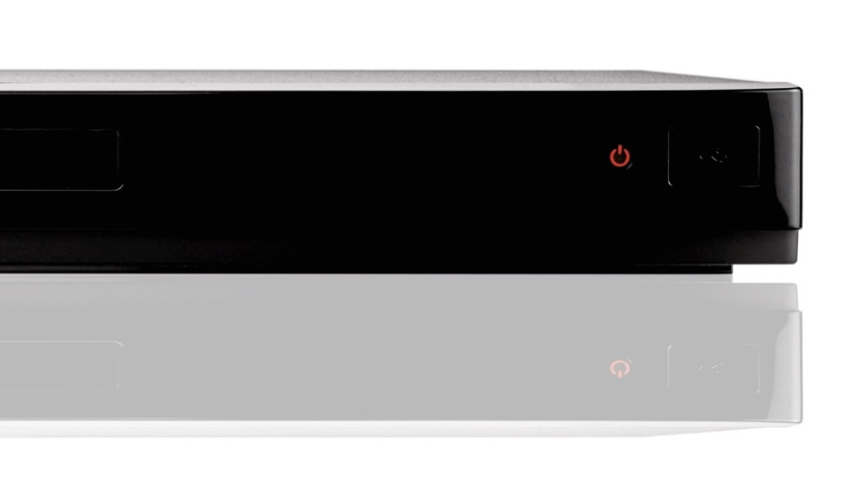
Notes:
Does anybody know what this red light signifies?
Encourage students to put up their hands or shout out suggestions.
It means that an appliance – like a TV, DVD player or games console – is still using power. So when you’ve finished watching a film or playing a game, make sure you don’t just turn the device off by the remote control, but you switch it off at the plug too.
If the red light is still on, the appliance is in what’s called ‘standby mode’ and is still using power – even if it looks like it’s switched off.
How much do you think it might cost if you left the TV and games consoles on standby all the time?
Encourage children to guess the right answer:
£5 a year?
£20 a year?
Up to £80 a year?
The answer is c). Leaving your TV and games consoles on standby could add an extra £80 a year onto your home’s energy bill (Source: Energy Saving Trust www.energysavingtrust.org.uk/about-us/news/brits-could-save-£17-billion-year-switching-appliances-standby)
Imagine if you left every TV in standby mode in your house, every games console, every appliance… that’s a lot of wasted energy and money, isn’t it?
Time to use a prop (optional): mobile phone and charger.
Do you have one of these? Or does somebody in your home? Remember that when your mobile phone has finished charging, it still continues to use power, even if it’s reached 100%. So when a mobile phone has finished charging, switch it off at the plug!

Slide 14
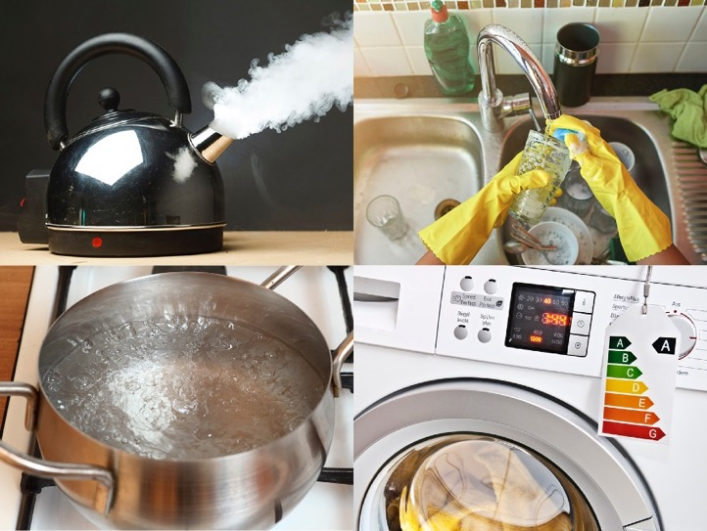
Notes:
Remember to encourage your family to save energy too – tell them it could save them hundreds of pounds*, which they’ll love!
What could you do in the kitchen to avoid wasting energy?
You could use props here again too (e.g. kettle, saucepan or washing up bowl).
Encourage students to put up their hands or shout out suggestions.
Don’t overfill the kettle – only boil the amount of water you need each time
Use a bowl for washing up, rather than rinsing dirty items under a running tap
Put lids on pans when they’re bubbling on the hob, as they’ll boil quicker
When buying new appliances – like a washing machine or fridge – remind your parents to look for energy efficient models
Don’t leave kitchen appliances – like juicers, mixers, the kitchen radio etc. – in standby mode, as this still uses power!
* Source: https://www.uswitch.com/energy-saving/guides/standby-savers/

Slide 15

Notes:
This slide is relevant if you’re using the presentation to lead into Switch Off Fortnight.
We’ll be learning more about saving energy during Switch Off Fortnight.
Switch Off Fortnight is a two-week campaign that’s all about saving energy. There are lots of fun things going on, and we want YOU to get involved.
Put in details of what the school is going to be doing to take part e.g.:
Look out for Switch Off Monitors checking what lights and appliances have been left on around school as part of our first switch-off audit (they’ll be running a second at the end of the fortnight to see if everyone has taken on board the message and saved energy) – they might be wearing some cool stickers.
Each class should write up what they’re going to do to save energy on this blue poster (hold up the Taking Part poster).
Look out for more posters on the walls, stickers on light switches and appliances that have been left on, to remind you about the importance of saving energy.
We can tell other schools on the Pod what we get up to by writing a blog or uploading an entry to the SOF Wall.
Run a Switch Off Fortnight audit at home using the Energy Audit to find out if your family could save energy too

Slide 16

Notes:
This slide is relevant if you’re planning to run a No Electricity Day.
We’re going to run a No Electricity on [insert date].
How long do you think you could go without power for?
You could ask students to raise their hands to suggest answers.
Let’s think about it. What was the first thing you did this morning that used power? How soon did it happen after waking? How have you used power at school so far today?
Invite students to contribute in response to each prompt.
The point of No Electricity Day is to make us realise how dependent we are on power. We might have to think of new ways of doing things – using pen to write on the board, for example, or having cold, rather than hot, snacks… But hopefully it will mean that we’re more careful about how we use energy afterwards; we stop to ask, ‘is it necessary to use power right now?’; and we switch off things when we’re finished, rather than leaving it for somebody else to do.
If you want to get involved in No Electricity Day or any of our other Switch Off Fortnight activities, speak to [insert relevant contact details]
We are one of hundreds of schools all over the world joining in [you could update this with live stats from http://jointhepod.org/sof] so let’s see if we can all make a difference by saving as much energy as possible!
Find out more about Switch Off Fortnight at http://jointhepod.org/sof There are lots of activities, games, films and teaching materials to involve the whole school, families and friends.
Don’t forget to use our Closing Energy-Saving Presentation (http://jointhepod.org/sofclosingassembly) at the end of your Switch Off Fortnight campaign. Make sure to take photos of what you get up to, collect together artwork that students produce and find out how much you could save on energy – in the school and at home – by running energy audits and encouraging families to do the same. You can then present everyone’s results and talk about the impact of the campaign in the closing assembly.

Slide 17
jointhepod.org

