Slide 1

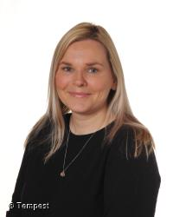
APPROPRIATE AND
EFFECTIVE
TEACHING AND LEARNING
Mrs Crehan works with children,
staff, parents and
outside agencies, to ensure
that all children
have their needs met
A PARTNERSHIP APPROACH
Mrs Crehan
Special Educational
Needs and Disabilities Co-Ordinator
(SENDCo)
OPEN AND HONEST
COMMUNICATION
Mrs Crehan can be
contacted on
(0121) 464 1730
or by email at
sendco@stedward.bham.sch.uk

Slide 2
Appropriate and Effective Teaching and Learning.
This section aims to tell you how we:
Train our staff to support your child’s needs.
Give extra support to your child if needed.
Ensure there is good teaching for your child.
Ensure that there is inclusion across the school for children and families.
Ensure that work is correctly pitched and differentiated for those children with Special Educational Needs.
It will also tell you:
What resources and support are available for the children.

Slide 3
Appropriate and Effective Teaching and Learning.
All teaching and support staff receive appropriate training. This ensures they have confidence and an up-to-date knowledge of teaching strategies to cater for children’s needs.
Weekly staff briefings take place during the school week. This keeps staff informed of individual circumstances.
A weekly staff meeting is also held. During these meetings we sometimes invite specialist agencies (for Speech and Language Therapist, Communication and Autism Team) who will deliver training to staff.

Slide 4
Appropriate and Effective Teaching and Learning.
The SENDCo works with class teachers in order for them to:
•Meet with parents/carers to review and formulate Pupil Passports to learning which contain appropriate strategies and targets for their child with special educational needs.
Review class assessment and attainment data.
Raise any concerns that they may have.
Discuss interventions and strategies that are being carried out.
Ask for any advice for resources and strategies for children with additional needs.

Slide 5
Appropriate and Effective Teaching and Learning.
There are teaching and support staff who have some specialist training or expertise to support children and run interventions throughout the week .
Here are some of the interventions that we run:
• Speech and Language e.g. colourful semantics
• Reading and Spelling e.g. precision teaching
• Writing e.g. use of scribe/technology
• Maths same day catch up workshops
• Pre - tutoring
• Social Stories

Slide 6
Appropriate and Effective Teaching and Learning.
We have a variety of resources available to support children’s learning.
Maths Games bags are available for children to take home and use, in order to enhance and support their mathematical development.
Reading books and schemes are used which means that the children have access to books in class and to take home that are at their level, and that encourage reading progress.
A variety of ICT equipment and software is accessed. We use iPads, PCs and laptops, recording equipment, digital cameras, smart boards and monitors with the children. Not only does the use of these items inspire and motivate, but it allows the children to access their learning and record their progress and achievement in many different ways.

Slide 7
Appropriate and Effective Teaching and Learning.
Specific equipment is also available for individual children that may have specific needs. Items such as colour overlays, fidget toys and visual timetables are available in school. We can obtain specialist furniture, monitors and radio aids from our Access to Education teams for children that may have mobility needs, hearing or visual impairments.
Furniture height, shape, positioning and size is carefully selected in each classroom to take into consideration the age of the children in the class. Outside agencies will visit to support and advise us how to cater for children with individual mobility, visual or hearing needs.
Working walls and displays prompt the children and help them to recall and retain knowledge and understanding.
The use of talk partners and talking groups encourages children to explore, explain and amend their ideas as well as giving them an opportunity to express their opinion.

Slide 8
Appropriate and Effective Teaching and Learning.
For children with significant needs, we have the following in place.
A Pupil Passport identifies the specific difficulty that a child may have and what support and resources are required to minimise their learning barriers. These are reviewed termly with parents, staff and if necessary, outside agencies
A SEND Support Provision Plan (SSPP) may be put in place, following outside agency advice, that can provide further funded support for a pupil. It identifies the high need, specific difficulty that a child may have and what support and resources are required to minimise their learning barriers. These are reviewed termly with parents, staff and if necessary, outside agencies.
• Various interventions/strategies delivered by trained staff. We liaise regularly with workers from the following outside agencies:
• LLSS (Language, Learning and Strategic School Support), Educational Psychology, Hearing Impairment and Visual Impairment Teams, Communication and Autism Team, Physical Difficulties Support Service, NHS Speech and Language Therapy.

Slide 9
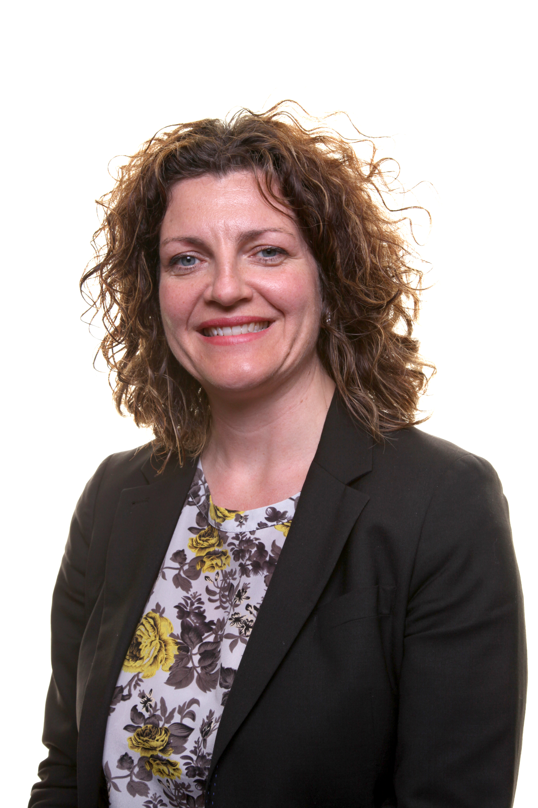
Appropriate and Effective Teaching and Learning
Which staff will support my child, and what training have they had?
Our special educational needs co-ordinator, or SENDCO is Mrs Crehan.
Mrs Crehan is the SENDCO in school and holds qualified teacher status, and worked at St Edward's since 2004.
All teachers and teaching assistants assistants in school have CPD throughout the year around a range of activities and strategies to support and teacher children with SEND in the classroom.
This training includes;
• ASD knowledge and awareness
• Colourful semantics
• Wave one support in the classroom
• Adaptive teaching
• Behaviour management
• Speech and Language support
• Attention Autism
This is not an exclusive list, and all training is ongoing and specifically tailored to the needs of the children in the school/class.
Mrs Crehan
SENDCo

Slide 10
Appropriate and Effective Teaching and Learning.
As well as highly skilled Teaching Assistants supporting the teaching and learning at St. Edward’s, we are also regularly supported by:
NAME | AGENCY OR ROLE
Aimee Hulse | Physical Difficulties Support Service
TBC | Teacher of the Visually Impaired
Sarah Sheppard | Teacher of the Hearing Impaired
Matt Blackburn | Communication and Autism Team
Rowan Bale | NHS Speech and Language Therapist
Emma Caddick | Soundswell Speech Therapy (school funded)
Erica Hewetson | Pupil and School Support Teacher
Philip Connor-Bell | Educational Psychologist

Slide 11
Appropriate and Effective Teaching and Learning.
We will provide good quality teaching for our pupils and additional support if needed.
Here at St.Edward’s we monitor your child’s progress through the following strategies.
1:1 meetings with class teacher and SENDCo
Book scrutinies
Moderation
Lesson Observation
Learning Walks
Monitoring of intervention planning
Teacher Assessment results
Tracking of progress and discussing this with teachers.

Slide 12
A Partnership Approach
This section aims to tell you how we will:
Work with you to identify your child’s needs.
Ask for your permission to involve other professionals to work with your child.
Involve you in decisions and listen to your views.
Involve your child in decisions about their learning.
Assist you in contacting organisations who can give advice and support.

Slide 13
A Partnership Approach
The Governing Body
The governing body has a duty to ensure that the school adheres to the new Code of Practice under the Children and Families Act 2014. Mrs Kennett as Headteacher, is held accountable by the governing body.
Anna Vile is the governors who is specifically responsible for special educational needs. Governors ensure that the school and the SENDCo carry out their duties.
One of the key responsibilities of the governing body is to make sure that the school’s policy for children with special educational needs and disabilities (SEND) is published on the school website. The information on the school website must be reviewed annually by the governing body.
The governing body also has a responsibility to ensure that appropriate safeguarding procedures are in place for all pupils, including those who have special educational needs and disabilities..
We will work in partnership with you, in order to support and assist you and your child in the best and most secure ways possible. We can also refer and liaise with other agencies if this is what is required by the family.

Slide 14
A Partnership Approach
Sometimes we may need to ask for your permission to involve other qualified professionals to support your child.
The governing body, through the SENDCo, ensures that other appropriate agencies are involved in meeting the needs of pupils with special educational needs.
The SENDCo reports regularly to the governing body regarding the number of pupils and their additional needs.
The governing body regularly reviews both policy and the information published on the website to ensure it is up-to-date, parent and pupil friendly and in line with government policy and the Code of Practice.
When another qualified professional works with your child, permission is granted through consent forms given in advance of the visit. The content of the visit is confidential and is only shared with parents, the SENDCo and the Class teacher. Please speak to Mrs Crehan if you require any further information.

Slide 15




A Partnership Approach
Parents or teachers raise a concern about the progress of a child. Discussion with parents/teacher/SENDCo takes place. Initial Concerns form completed.
Assessments/observations are carried out and checklists completed
to find out the specific need(s) of the child.
Targets to address the needs are written with parents and pupils. Resources and teaching approaches are identified. A Pupil Passport may be implemented.
Ways to help at home
are discussed
Possible involvement of outside agency.
Any concerns are addressed.
Progress is continuously monitored.
Teaching takes place in accordance with the Pupil Passport Interventions, progress and learning is monitored
Outcomes are assessed are reviewed with the parents and the child during termly Parents Evening. We assess what’s worked well, what still needs to be worked on.

Slide 16
A Partnership Approach
At St. Edward’s, we will involve your child in decisions about their learning, wherever appropriate. Here are the different ways that we can consult with children and listen to their views.
Pupil Conversations
Open Door Policy – Children can talk to SENDCo, as well as class teacher
Pupil Passport Consultation/Review – pupils can attend this meeting along with parents/carers, school staff and professionals
Pupil Passport pupil voice
Teacher marking and feedback
School Council Meetings

Slide 17
A Partnership Approach
We are always happy to provide you with the contact details of agencies and services that may be able to offer assistance and support for you and your child.
LOCAL AUTHORITY OTHER SUPPORT SERVICES
HEALTH SERVICES
Home - Local Offer Birmingham website
Name of Agency/Service | Contact
Communication and Autism Team | CATParentEnquiries@birmingham.gov.uk
Physical Difficulties Support Service | PDSSparentenquiry@birmingham.gov.uk
Sensory Support Service | 0121 303 1793
Language, Learning and Strategic Support Team | Heather.Wood@birmingham.gov.uk
Educational Psychology Service | South Team - 0121 303 8288
Name of Agency/Service | Contact
Social Services | 0121 303 1888
Autism West Midlands | 0121 450 7575
The SEND Information, Advice & Support Service (SENDIASS) | 0121 303 5004
Edward’s Trust (Bereavement Support) | 0121 454 1705
Name of Agency/Service | Contact
Speech and Language Therapy | 0121 466 6231
School Nurse | 0121 245 5750
Allens Croft Child Development Centre | 0121 466 4700
Forward Thinking Birmingham | 0300 300 0099
Occupational Therapy | 0121 303 3865

Slide 18
Open and Honest Communication
This section tells you:
How to speak to school, if you have a concern.
How we try to make the information about your child clear and easily understood.
Which agencies might become involved with your child.
How we ensure the necessary people know about your child’s needs.
What happens when your child moves school.

Slide 19
Open and Honest Communication
If you have a concern about your child, the SENDCo is available to speak to you. We always encourage you to speak to your child’s teacher, in the first instance.
The SENDCo works on Tuesday and Wednesday in school. Sometimes she may be in meetings, training, or she might not be in the building so you can do the following:
Speak to Miss Sankey, Mrs Hooper or Miss Connolly in the office to find out when she may be available and make an appointment.
Telephone her on 0121 464 1730
You can also email her on sendco@stedward.bham.sch.uk
We operate an open-door policy and you are welcome to come into school.
We hold regular termly Parents Evenings so that you can find out how your child is doing in school.
Attend one of our Termly Coffee Mornings/Afternoons (Details will be in the weekly emails, Friday Letter, on our website in the SEND/Inclusion section, on Instagram, and Twitter.)

Slide 20
Open and Honest Communication
We will make all the information we need to share with you clear and easy to understand. If it isn't please come back to us.
You can read our Inclusion Policy on our website. The policy explains how we identify and assess children who we think might have special educational needs.
If you prefer information on paper, please ask for a copy of our Inclusion Policy. Please ask Miss Sankey, Mrs Hooper or Miss Connolly in the office.
Our Governing Body has a governor who is responsible for special educational needs and disabilities. Her name is Anna Vile.

Slide 21
Open and Honest Communication
St Edward’s works with a lot of external agencies to help identify specific needs. These are:
Language, Learning and Strategic Support Team
Speech and Language Therapy
Communication and Autism Team
Educational Psychologist
Physical Difficulties Support Service
If your child requires support from these services, school will always consult with you and request written permission.

Slide 22
Open and Honest Communication
The SENDCo will make sure that all necessary school staff are aware of your child’s needs and worries.
If your child has been identified with extra educational, emotional or behavioural needs, a Pupil Passport will be written by teacher during a consultation meeting with you and your child with appropriate strategies and targets.
If your child has medical needs, a plan will be written and shared with you.
All staff have access to a copy of these plans in the classroom and via an electronic system. The plans identify how your child should be helped to succeed and make progress.
Occasionally, your child’s teacher may not be in class and this extra information is useful for the covering teacher.
All of these plans will be reviewed on a regular basis – at least once a term.

Slide 23
Open and Honest Communication
If school thinks your child needs extra support, we will always talk to you about this.
Your child’s teacher will talk to you about the progress that has been made each term. We also operate an open door policy and you can make an appointment to speak to your child’s teacher or the SENDCo at any point during the year.
If your child requires a Pupil Passport, this will be discussed and reviewed each term with you and your child.
If your child has more complex needs and may require an Education Health Care Plan, then we will review your child’s progress and needs through a Team Around the Child Meeting (TAC). This approach very much values the views of the child, the parents as well as the school’s.

Slide 24
Open and Honest Communication
Your child’s progress will be reviewed regularly, and you will be invited into school to discuss the outcomes and give your views. Your child’s views will also be listened to.
We use a set of criteria to assess some of the children who are working below or significantly below the same level as national benchmarks. This is done regularly. Should there be any concerns, teachers complete an Initial Concerns Checklist in consultation with all those in school who work with the child.
This helps us identify any targets your child may need to make faster progress in English or Maths. We use the criteria to make a Pupil Passport. This plan is constructed in consultation with you and your child and sets out what needs to be in place for your child to make as much progress as possible. We then review it each term during Parents' Evening, and talk about what has gone well and what might still need to be worked on.
Sometimes children no longer need a Pupil Passport because they have caught up with national benchmarks.
There are sometimes occasions where we involve outside agencies, such as the Language, Learning and Strategic Support Team to support us in making our assessments and these agencies offer advice.

Slide 25
Open and Honest Communication
If your child has a Pupil Passport, SEND Support Provision Plan or an Education Health Care Plan and you move your child to another school, the SENDCos at both schools liaise to make sure that information is shared.
If your child is at Nursery School and is about to start in Reception here, we liaise with the staff and SENDCos at the nursery schools to find out as much information as possible about your child’s needs. This will include any targets and paperwork or agencies which might have been involved in supporting your child. We also arrange for pre-school visits.
When your child moves from Year 6 to secondary school, the SENDCo will ensure that all information regarding your pupil’s special educational needs are passed on to the new SENDCo. Extra visits to the secondary school may be arranged and sometimes the new SENDCo will come to review meetings held at St Edward’s.

