Slide 1
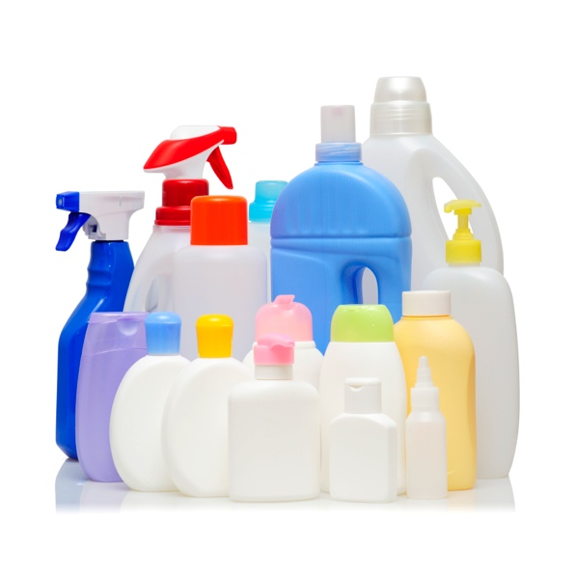
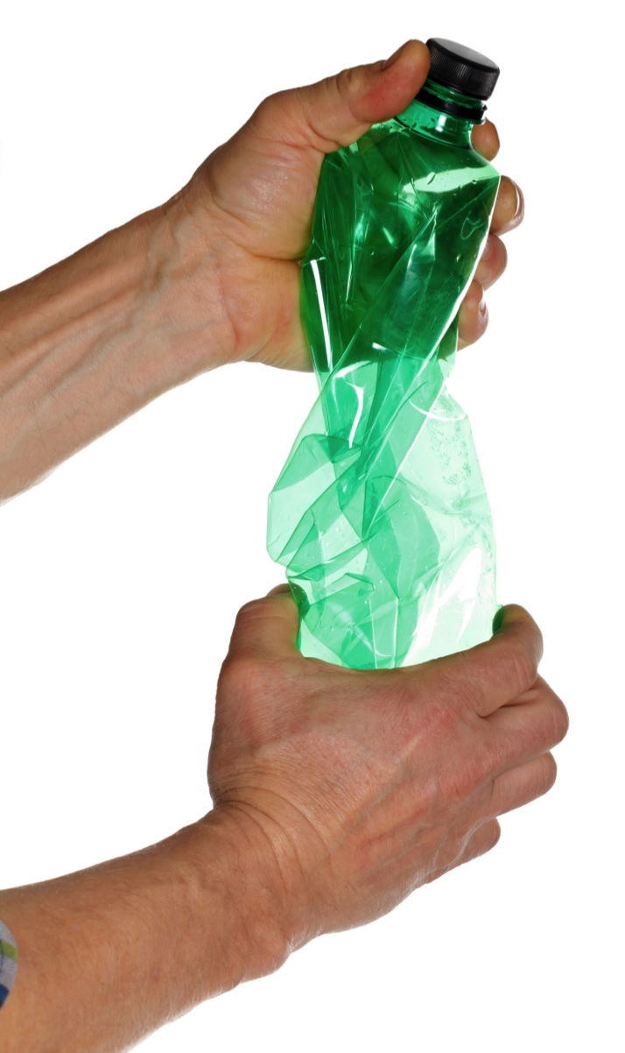
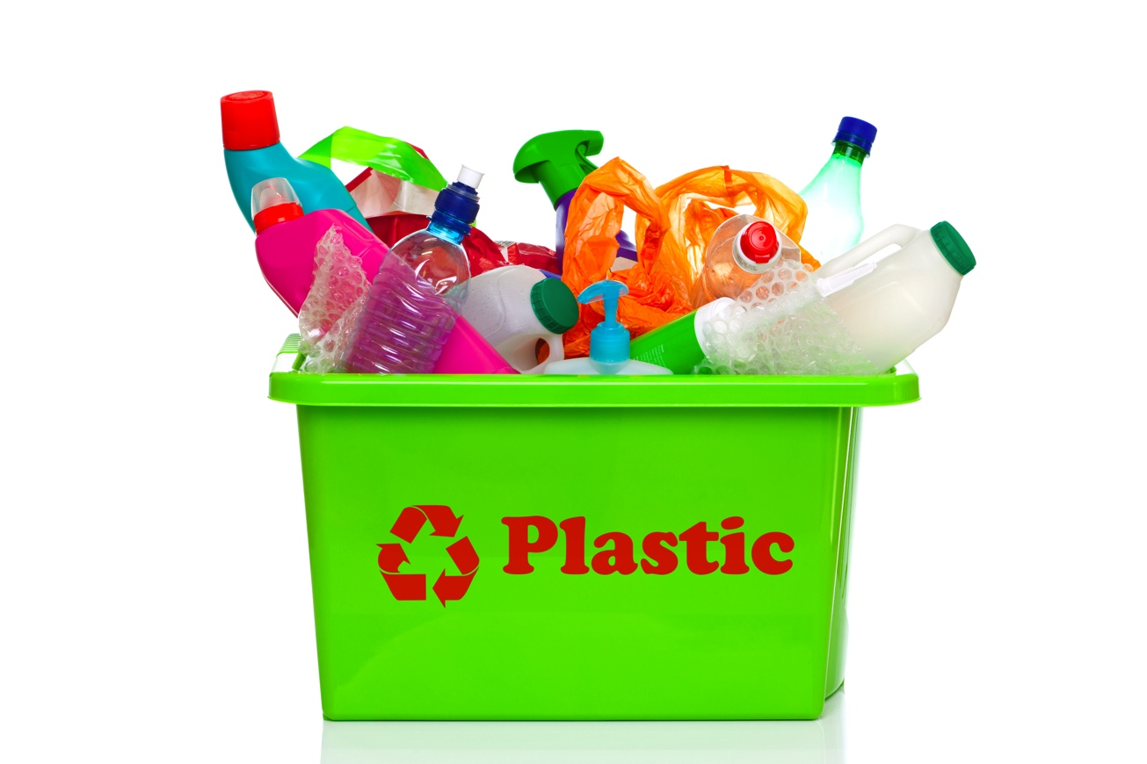
What’s the problem with
single-use plastic?
Less plastic, more fantasic!
Notes:
The presentation consists of 11 slides, each with teachers’ notes.
The notes are designed to help you present some key ideas and prompt questions and discussions about some of the issues with students. Use it to support any learning about waste or the recycling topics.

Slide 2
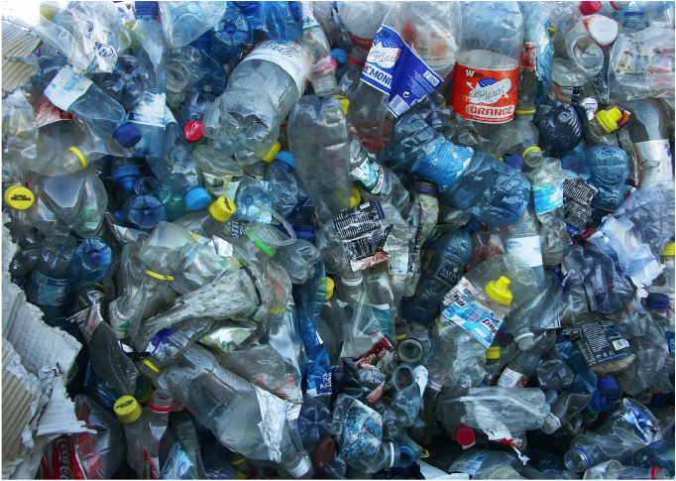
What are plastic bottles made of?
Notes:
What raw materials are plastic bottles made of?
Ask students if they know which raw materials are used to make plastic bottles.

Slide 3
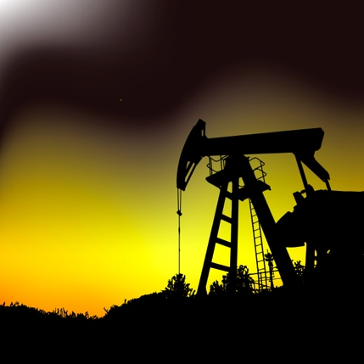
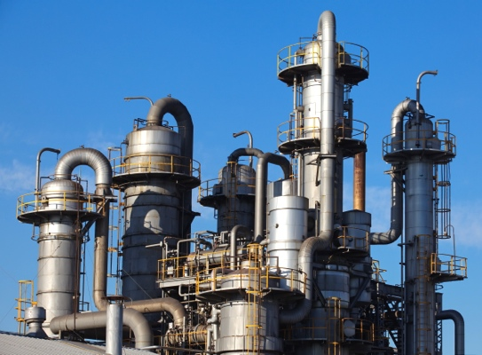
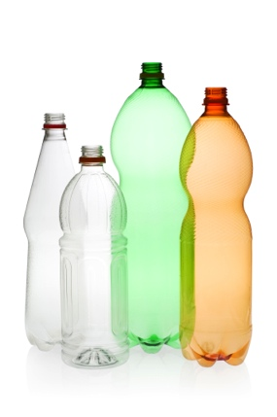
What are plastic bottles made of?
Crude oil
Oil refinery
Made into bottles
Notes:
What raw materials are plastic bottles made of?
Plastic is made from crude oil, which is extracted from under the ground. This is a fossil fuel, made from plants and animals that died millions of years ago. It is a non-renewable resource – there is only a limited amount of it and it’s running out!
An oil refinery separates the crude oil into different chemicals, and some of these are processed to turn them into plastic.
It takes a lot of energy to make plastic. Extracting it from the ground is difficult, and refining the crude oil and turning it into plastic needs lots of heat - this often comes from fossil fuels being burned, releasing carbon dioxide into the atmosphere which isn’t good for the planet.

Slide 4
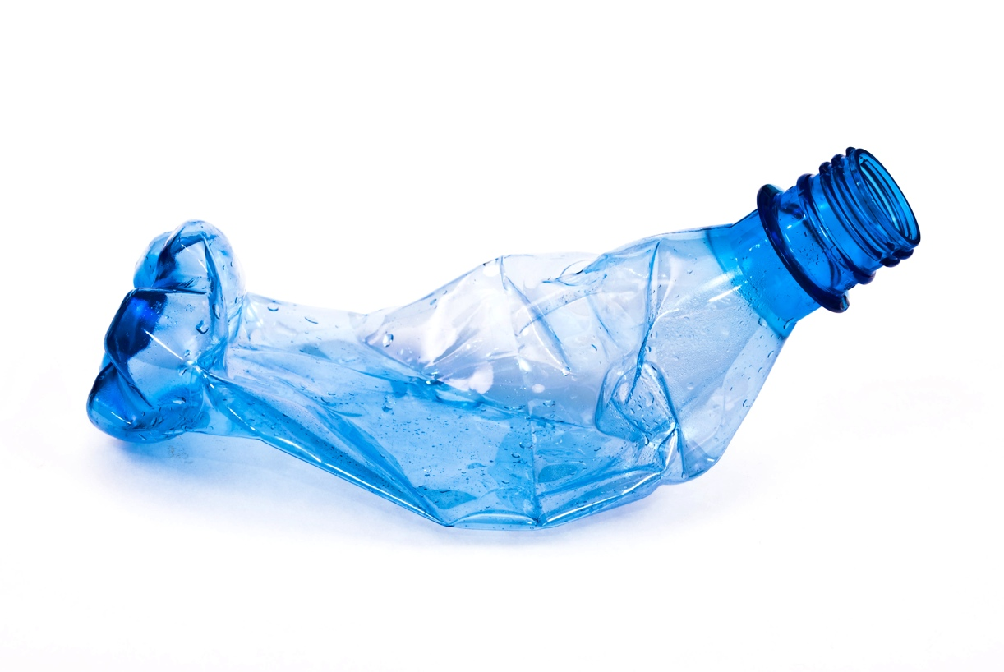
Where do they go?
What happens to our plastic bottles when
we’re finished with them?
Notes:
What do we do with our plastic bottles when we’re finished with them?
Ask students what they do with their plastic bottles. Some may say throw them away, some will say recycle.

Slide 5
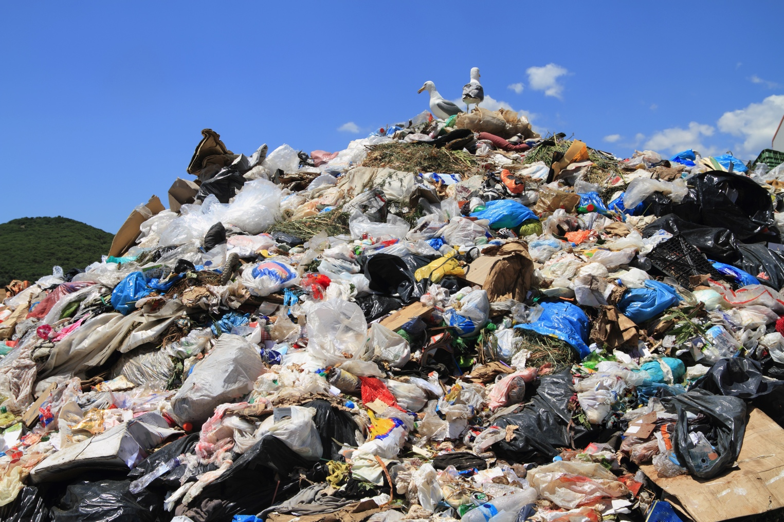
Landfill
Notes:
Landfill
A great deal of our plastic waste goes into landfill – we throw it in the bin, it’s collected by refuse collectors, and it gets buried in the ground.
The type of plastic that is commonly used to make bottles (PET) can take hundreds of years to degrade in a landfill as it depends on a lot of different factors like acidity. This type of plastic is actually sold with a 100+ year guarantee for geotextile use, where it is buried to strengthen the ground around big building projects like roads!
Source – Plastics Europe

Slide 6
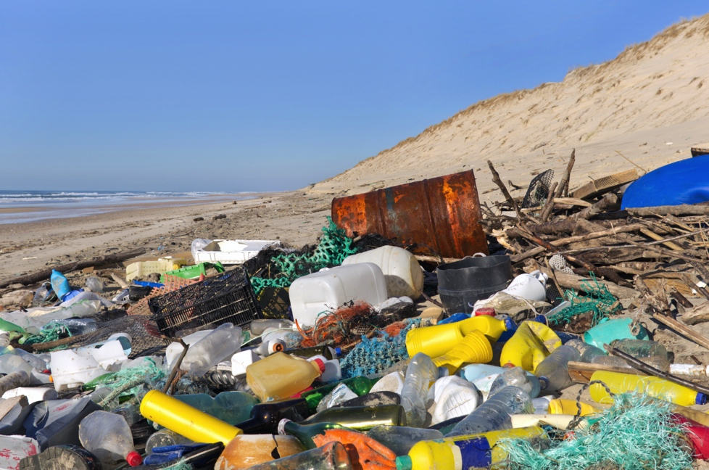
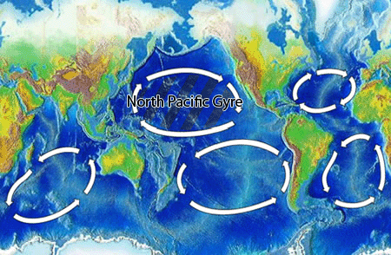
The Environment
Notes:
The Environment
A lot of plastic also makes its way into the environment, particularly the oceans. The currents sweep it together and it collects on beaches and in great patches in the sea.
Did you know that there is a floating mass of plastic waste in the Pacific Ocean, that’s 6x the size of the UK?! It’s called the Great Pacific Garbage Patch, and nobody knows exactly how much plastic is in it, but scientific samples show that in some areas there are 6x as many plastic particles as plankton*!
Whether it’s in the ocean or on the shore, animals can eat plastic or get trapped in it – this can injure and even kill them.
Information on this page is sourced from Plastic Oceans unless otherwise stated.. More info is available online, including at http://www.plasticoceans.net/the-facts/, and videos that could be shown at http://www.plasticoceans.net/media/videos/.
* source: C.J Moore, S.L Moore, M.K Leecaster, S.B Weisberg, A Comparison of Plastic and Plankton in the North Pacific Central Gyre, Marine Pollution Bulletin, Volume 42, Issue 12, December 2001, Pages 1297-1300

Slide 7
Recycling
Notes:
Recycling
Can you believe that only 58% of plastic bottles are currently recycled? That means that 42% of the plastic bottles that people use are going to landfill or being left in the environment!
Many plastics can be recycled – most households and businesses have recycling bins to make this happen. Who knows where their recycling bin is at home? At school? Recycled plastic can be used for pretty much anything that new plastic can – bottles, tools, toys…
Recycling saves fossil fuels and uses less energy than making new plastic, but it still isn’t perfect – it still takes energy to recycle plastic bottles (around 60% as much as making the bottle from scratch) and some kinds of plastic can’t be recycled at all.
Recycling percentage source: http://www.wrap.org.uk/content/plastic-bottle-recycling
Energy proportion source: http://www-g.eng.cam.ac.uk/impee/topics/RecyclePlastics/files/Recycling%20Plastic%20v3%20PDF.pdf

Slide 8


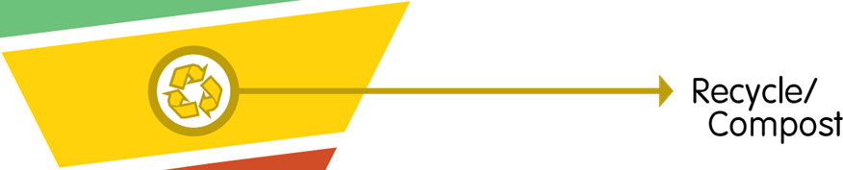
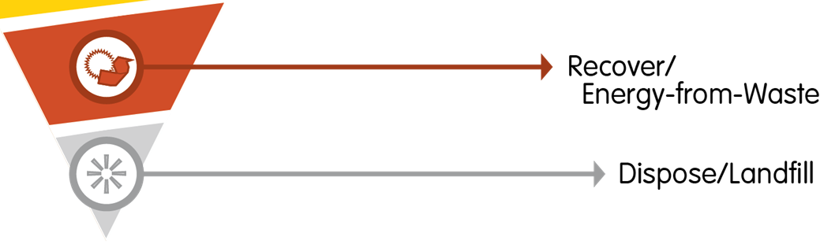
Reduce
Reuse
Recycle
Notes:
Reduce, reuse, recycle
So plastic is really useful, but there are some issues with the way that we use it, and even with recycling. How can we manage our use?
In presentation mode, click to switch focus between ‘Recycle’, ‘Reuse’ and ‘Reduce’
You may have seen something like this before – there are lots of ways in which we can improve what we do with our waste.
At the bottom we have Landfill – just burying it in the ground. What do you think of that?
Next is recovering – e.g. burning our waste to heat water and make electricity. Are there any disadvantages to this?
Recycling is in the middle – we’ve talked about the pros and cons of this.
Why is reuse above recycling?
Reducing is at the top – that means cutting down on the amount we use in the first place. What are the advantages and disadvantages of this?
These are all important parts of a sustainable world, and we should try and change our habits to move towards the top of this list.

Slide 9

How much do we use?
× 5 days/week = 5 / week
× 4 people/family…
1 plastic bottle a day = 5 per week = 195 in a school year (39 weeks)
4 people per family = 780 per household
30 students per class = 5,850 per class (23,400 including families)
5 classes per year group = 29,250 per year group (117,000 inc families)
7 year groups per school = 204,750 per school (819,000 inc families)
Notes:
How much do we use?
For younger students you may wish to summarise this section
It might feel like one person reducing, reusing or recycling their waste is a little bit pointless – after all, what difference does that make in the grand scheme of things?
Let’s have a look at how things scale up…
1 plastic bottle a day = 5 per week = 195 in a school year (39 weeks)
30 students per class = 5850 per class
5 classes per year group = 29250 per year group
7 year groups per school = 204750 per school

Slide 10
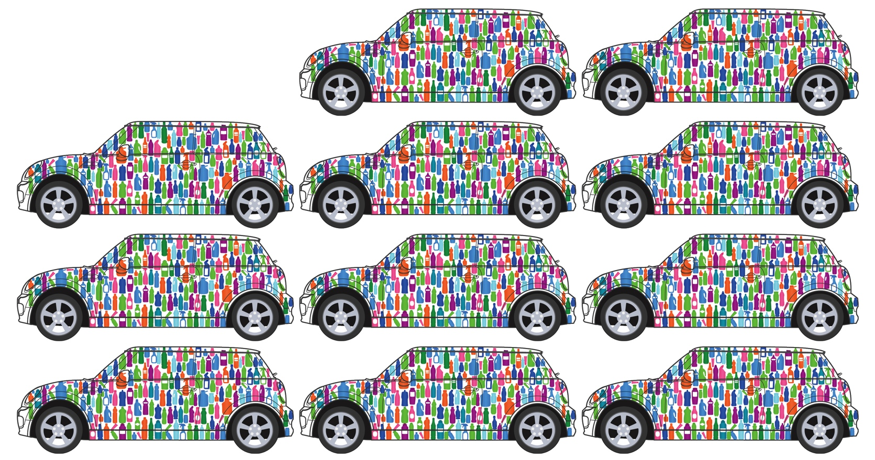
How much do we use?
Notes:
How much do we use?
For younger students you may wish to summarise this section
It might feel like one person reducing, reusing or recycling their waste is a little bit pointless – after all, what difference does that make in the grand scheme of things?
Let’s have a look at how things scale up…
1 plastic bottle a day = 5 per week = 195 in a school year (39 weeks)
30 students per class = 5850 per class
5 classes per year group = 29250 per year group
7 year groups per school = 204750 per school

Slide 11
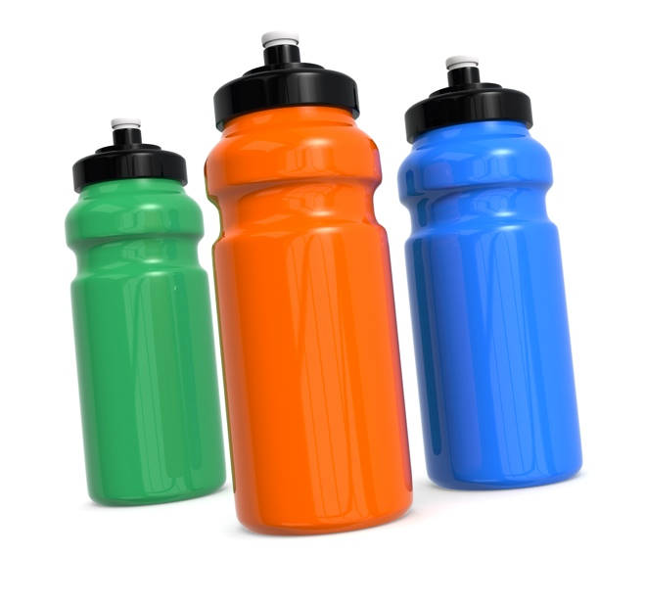
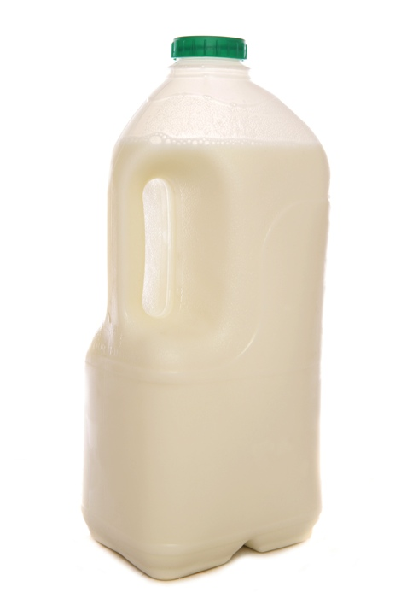
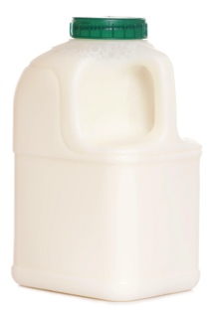
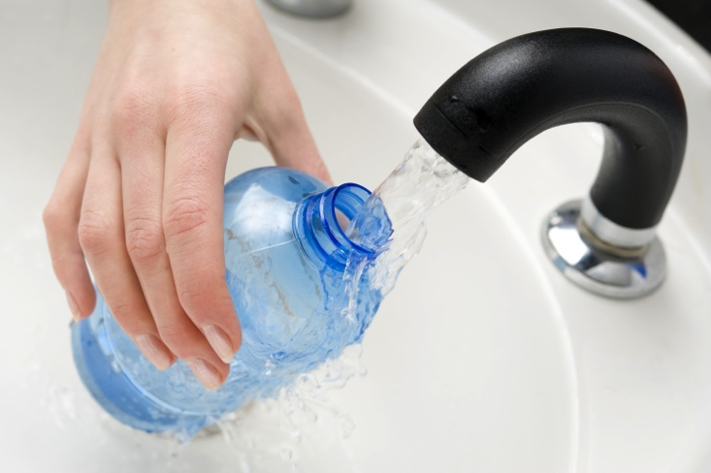
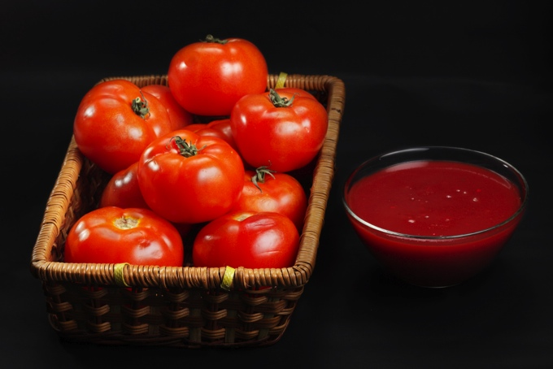
What can we do?
Notes:
What can we do?
How to reduce your and your family’s usage?
Use a reusable water or juice bottle.
Refill bottles from the tap (in fact, tap water is subject to stricter quality controls than bottled water!). For safety reasons use refillable bottles where possible to avoid carcinogens.
Buy things in bulk (ketchup, milk, etc), or even try making your own!
What about recycling?
Do you recycle all of your plastic bottles?
What about ones from the bathroom?
What about when you’re out and about – do you take your bottles home to recycle?

Slide 12
Recycling
Let’s make a
difference!
Notes:
If we all reduce our household’s usage we can make a real difference!
Think about the materials and energy needed to create plastic bottles. Recycling is important so make sure you’re doing that. Reducing can save even more energy – see what you can do and all of your efforts will add up and up!
Any questions?
Leave students enthusiastic about making a change, and aware of the impact that their collective action can make. In Waste Week, let them know that students across the country are doing the same.

