Slide 1

Welcome to Year 5

Slide 2


Slide 3
Our school prayer
Heavenly Father,
This is our school. Let peace live here
Let the rooms be full of happiness.
Let Love live here; Love of God; Love of another and love of life itself.
Let us remember that as many hands build a house, so many hearts build a school.
Amen

Slide 4


Slide 5

Being a Catholic school and opportunities for your child
Virtues
Catholic Social Teaching
Collective worship
Assemblies
Faith Friends Y3 & Y6
Liturgy Leaders
Sacramental programme
Mass reminder
Responsibility for..
Developing a good conscience
Making good choices
Showing empathy
Read and present to an audience

Slide 6
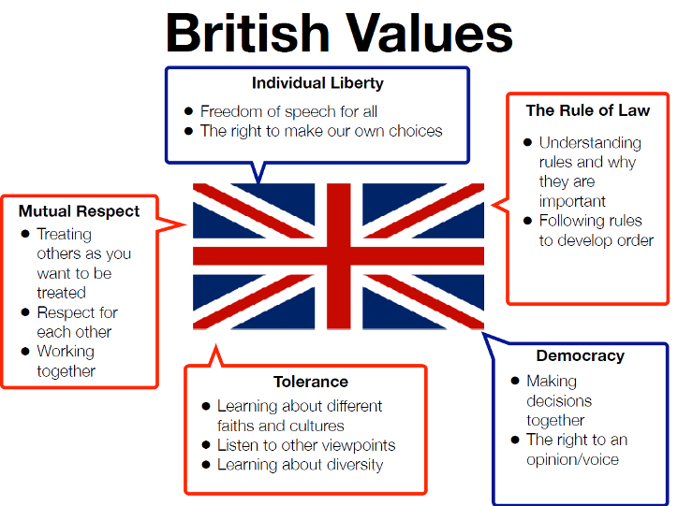

Slide 7
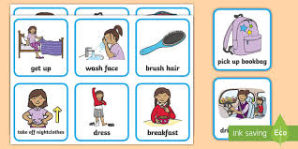
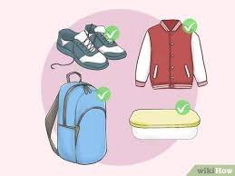
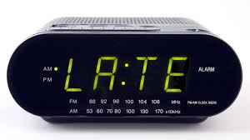
Punctuality is a good habit
Punctuality or Lateness
5 minutes late every day= a day missed every half term
Attendance
90%=19 days=4 weeks=100 lessons missed80%=38 days=8 weeks=200 lessons missed
70%=57 days=11.5 weeks=290 lessons missed
Lateness
5 minutes late every day= a day missed every half term
0%=19 days=4 weeks=100 lessons missed
80%=38 days=8 weeks=200 lessons missed
70%=57 days=11.5 weeks=290 lessons missed
Lateness
5 minutes late every day= a day missed every half term

Slide 8
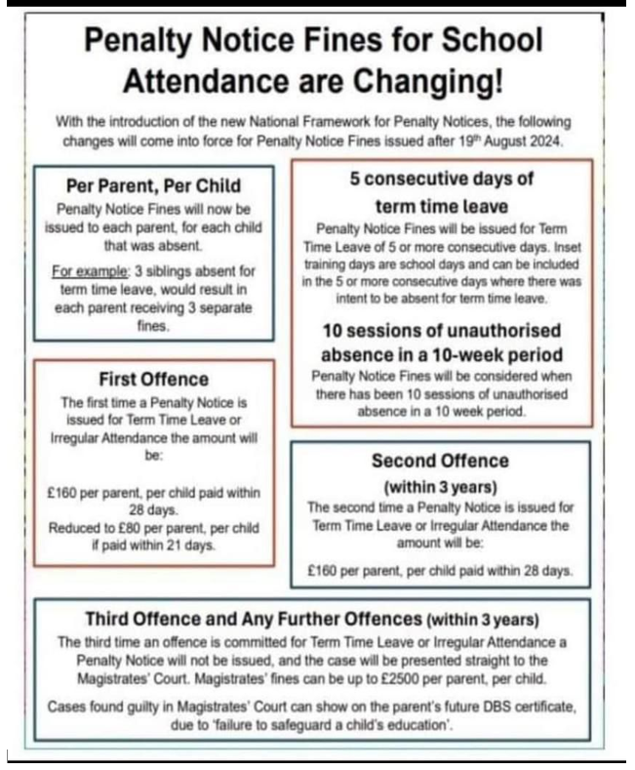

Good Attendance gives your child the best start
90%=19 days=4 weeks=100 lessons missed
80%=38 days=8 weeks=200 lessons missed
70%=57 days=11.5 weeks=290 lessons missed
Absence reporting
Phone school office or complete the form on the school website for the first day only
Attendance

Slide 9

Limit the use of Mobile phones
No mobile use in church
No mobile use during masses and prayer services

Slide 10
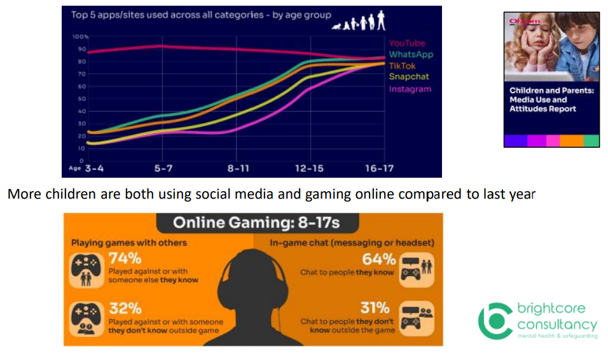
Internet use at home

Slide 11
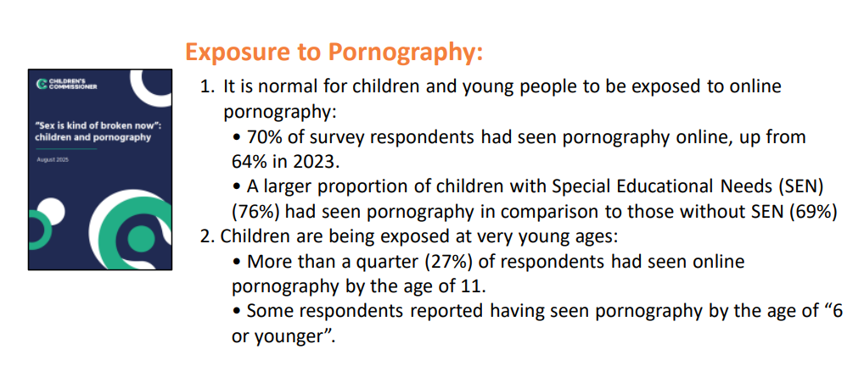

Slide 12
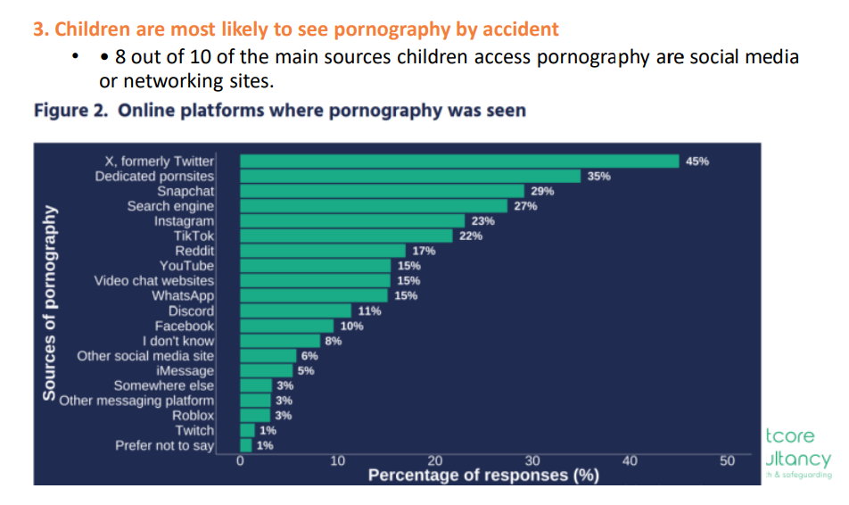

Slide 13
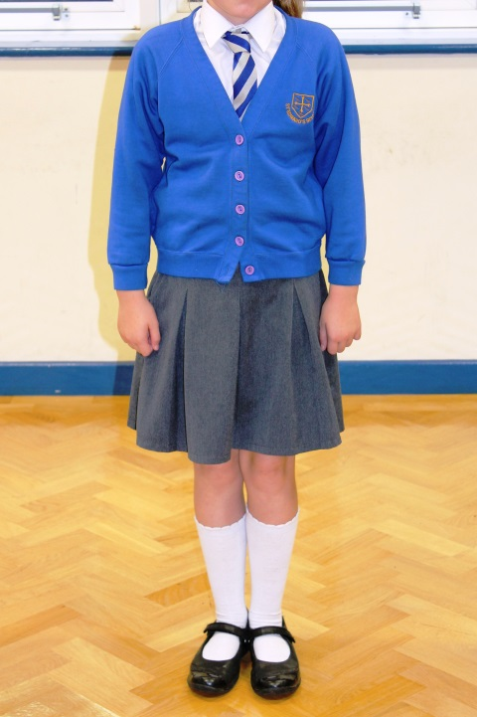
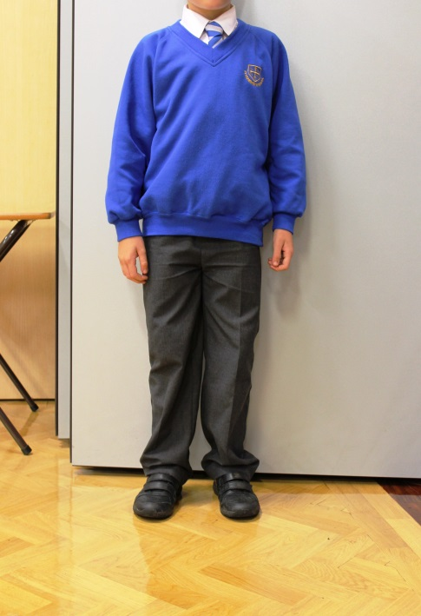
Uniform at St. Edward’s
Winter
Keep it simple!
Label uniform, coats, sandwich boxes & water bottles
All children must now wear a white shirt with a tie. No polo shirts.
School logo is only needed on the school jumper or cardigan.
Black school shoes, not trainers.
No earrings.
Long hair tied back & small bows in school colours, no extreme hair styles.
PE Kits (on PE days)-white plain t-shirt and royal blue shorts; royal blue or navy jogging bottoms for the winter

Slide 14


Slide 15
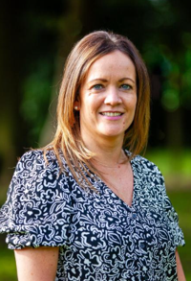
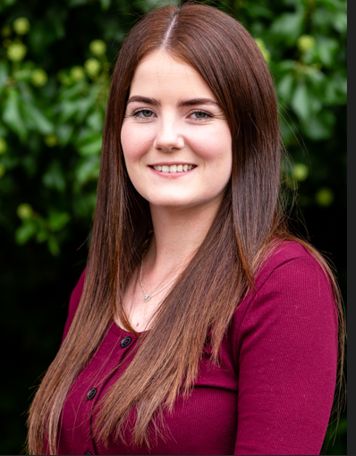
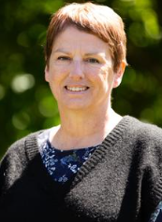
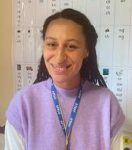
M
Our Team
Mrs Kendrick Assistant Head
Curriculum Lead
Miss O’Brien
Italian Lead
Mrs Agnello
Miss McIntosh

Slide 16
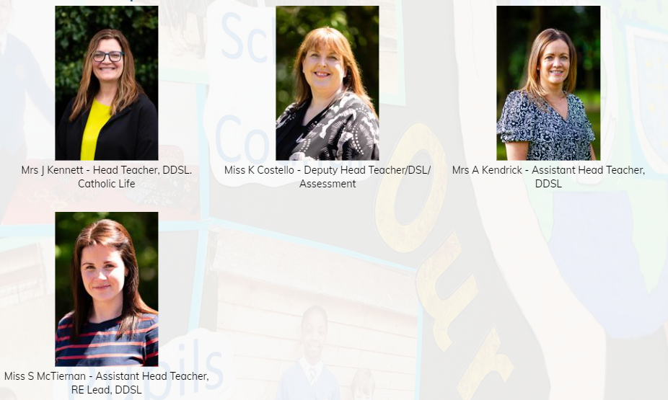
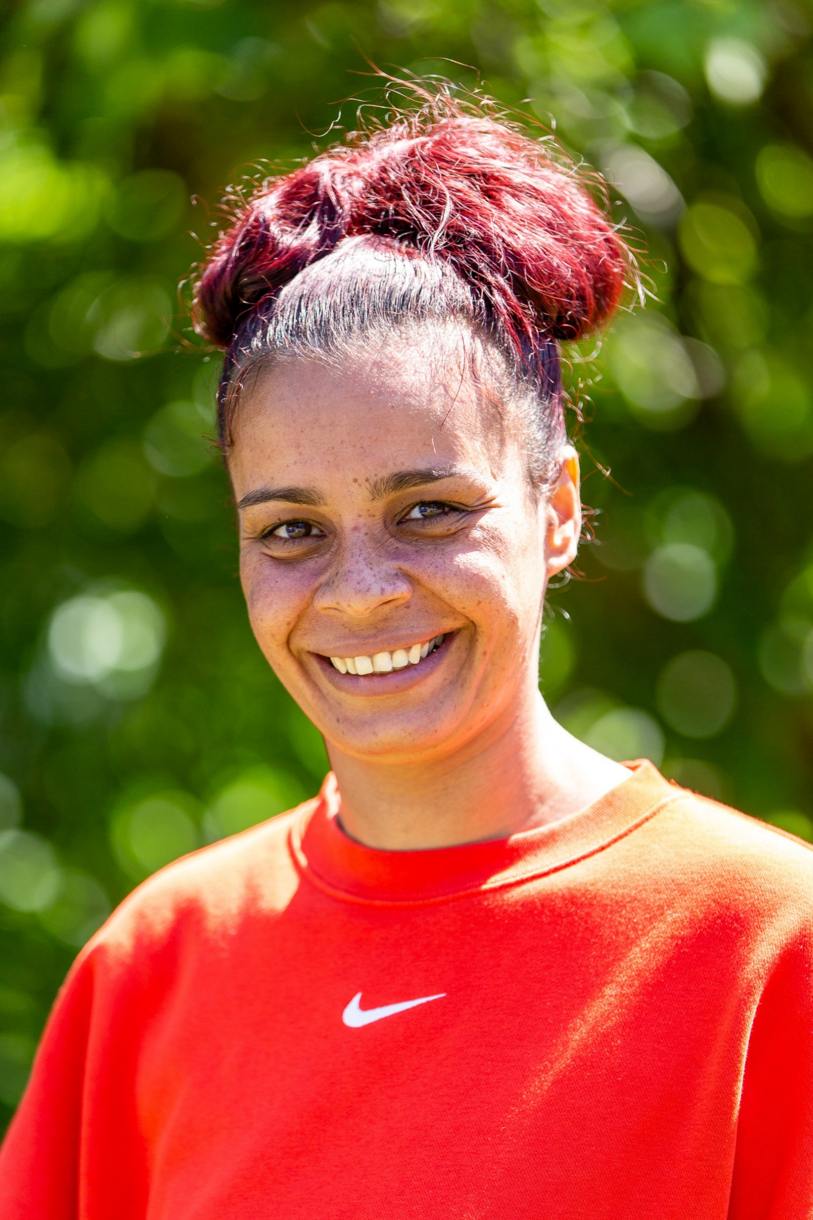
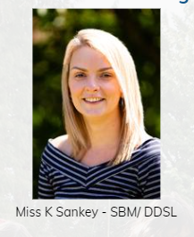

Designated Safeguarding Leads (DSLs)

Slide 17



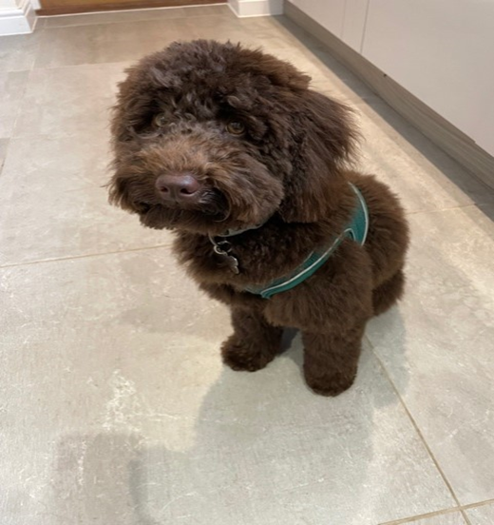
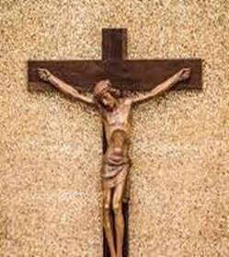
Pastoral team
Family Support Worker Trevina
3 days per week
SENDCO
Pastoral TA’s
Trained in counselling
Dog Mentor Programme

Slide 18

Safeguarding Paws
You will see these in your child’s classroom
stuck on a display so that they are easily
accessible for them.
We complete them every term as the
children get to know more staff and
relationships may change.
Children are asked regularly who is on their paw. This enables them to ensure they report problems or worries.

Slide 19

Communication
Year group email
  Checked regularly but please allow 48 hours for a response.
  teacher@stedward.bham.sch.uk
  enquiry@stedward.bham.sch.uk
Make an appointment with the teacher after school.
  Wait until all children have been dismissed from the playground.
  Please see Class Teacher first before approaching SLT.
Friday Letter (fortnightly)-link to it on the front page of the website
Weekly email
Year group pages

Slide 20
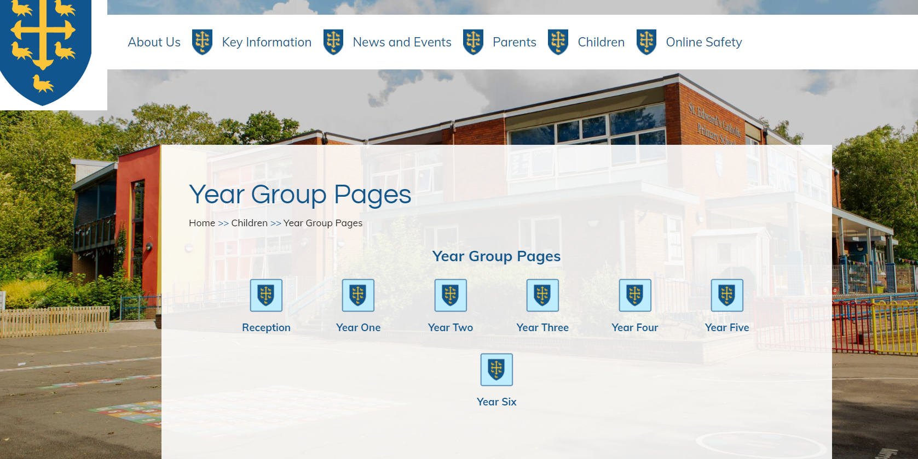
https://www.stedward.bham.sch.uk/year-six/

Slide 21
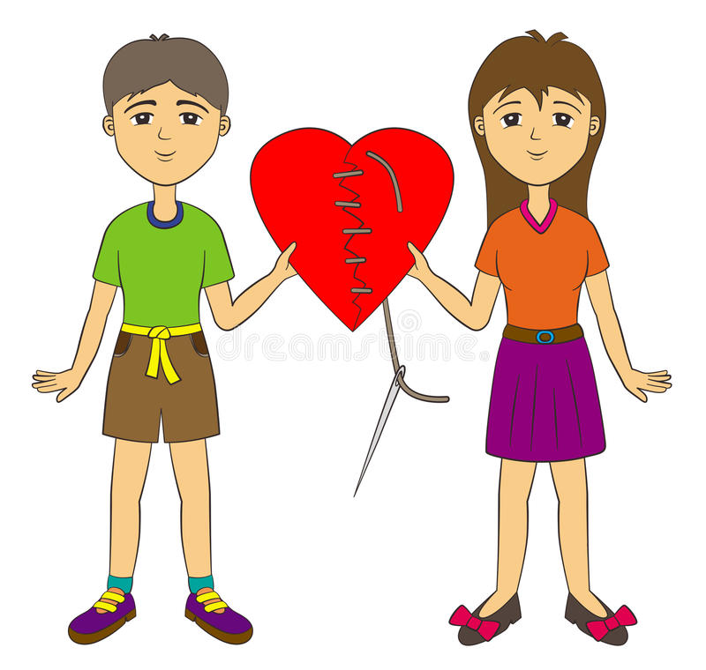
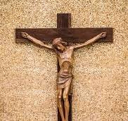
Things to remember……
Everyone – child/staff/parents can make a mistake…
A child receiving a ‘red’ is not the end of the world!
We work hard with children, parents and peers if we see or hear about bullying behaviours, taking a restorative approach.
If you have a concern please come straight to your child’s teacher so that we can investigate further – we always have your child’s best interests at heart.
Every day is a new day! This is important if we are showing true forgiveness.
Please help your child to be resilient – they need to sort out their own disagreements and come to a resolution. This is a life skill

Slide 22

Rewards...
Track-it Points in each lesson
Certificates for 100, 200, 300, 500…points
House points collated weekly
Star of the Week receives a certificate & Tea with Mrs K and the School Dogs in the staffroom
Eco, Digital, Liturgy
Millie Moments
Class rewards for Attendance & Punctuality
Team points
Focus on positive praise – children receive lots of greens and we celebrate the good!

Slide 23

Behaviour
Orange/Yellow/Red
Red is for more serious incidents and children will receive a suitable and meaningful consequence
Exclusion is rare but sometimes necessary e.g. Intentional physical
Sometimes children need more individual support to ensure good behaviour
We cannot share information about other children and we need your support
If other parents report things to you please let us know

Slide 24
P.E. Kit –Monday and Thursday
A white round neck t shirt.
School logo is not needed.
Royal blue shorts or blue/black tracksuit bottoms.
Trainers.
School jumper or cardigan, not a hoodie.
Children should not wear any alternatives.

Slide 25

Lost Property
Please ensure everything is labelled. We can only find it if it has a name and class.

Slide 26

Healthy snacks please
Please help us to cut down on the creation of litter and improve health.

Slide 27
Homework…. From 22nd September
Homework will be set on Monday and is due in on the following Monday.
This will be sent home in children’s bags.
It will include a Maths activity, a reading or writing task and a list of spellings. We also have TTRS.
We will be monitoring and following up with handing homework in.
Spellings will be set on a Friday and spelling tests will happen on a Monday.
Children will need to ensure that their reading books are in school everyday so that we can hear them as often as possible. Lost books will be charged at £5 for KS1 and £7 for KS2 books or require a like for like replacement.

Slide 28

Join a Writing Lesson
WB: 13th October
Sign up sheet to follow.

Slide 29

Parent and Child Online Safety Workshop
Thursday 6th November pm

Slide 30
Appreciation of the World
Opportunity for the children to learn about the world around them.
Examples:
Musician of the Month
Author Focus Days
Key Events

Slide 31
Key moments this year
Open lessons
Workshops
Masses
Advent & Lent
Christmas Carol Concert
School Council opportunities
Outdoor Days
Residential

Slide 32


Any Questions?

